Slide 1
Capstone Topics: Defining the Need, Creating Value
Aerospace
Junior
Design

Slide 2
Today’s Topics
1. Cultivating an “entrepreneurial mindset”
Curiosity, connections, creating value
2. Defining Capstone Topic Areas
Practical Constraints & Limitations
Existing topics
3. Idea creation and topic ideas …

Slide 3
Design begins with a NEED…
so cultivate an
“entrepreneurial mindset”
This is a mindset,
not about creating a new company…
In existing firms: Seek to understand the real need and look for opportunities to add value.
Entrepreneurial vs Traditional Engineering (2minute video: ) https://www.youtube.com/watch?v=ufdgKZ_3Zco&list=PLvITFYQeu1sFKecbGpVFBH44TCFnbanly

Slide 4
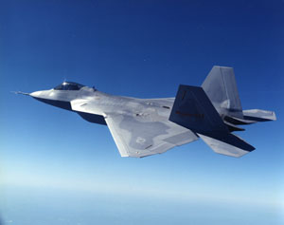
Aerospace Industry Design Example
Often the customer identifies a specific need that others try to satisfy:
Example: The Air Force needs an advanced tactical fighter.
They do a study & define requirements for a stealth fighter.
They issue a “Request for Proposal” (RFP) and find a company to produce the product.
Producers (e.g. Lockheed Martin/Boeing)
Understands the need; refines requirements
Conducts preliminary design
Completes detail design
Produces the F-22
Customer (Air Force)
Uses product
Notes:
In 1981 the U.S. Air Force developed a requirement for an Advanced Tactical Fighter (ATF) as a new air superiority fighter to replace the F-15 Eagle and F-16 Fighting Falcon. Code named "Senior Sky", this program was influenced by the emerging worldwide threats…. Prime contractor Lockheed Martin Aeronautics manufactured the majority of the airframe and performed final assembly at Dobbins Air Reserve Base in Marietta, Georgia; program partner Boeing Defense, Space & Security provided additional airframe components as well as avionics integration and training systems.[19] F-22 production was split up over many subcontractors across 46 states to increase Congressional support,[20][21] though this production split may have contributed to increased costs and delays.[22] Many capabilities were deferred to post-service upgrades, reducing the initial cost but increasing total program cost.[23] Production supported over 1,000 subcontractors and suppliers and up to 95,000 jobs.[24]

Slide 5
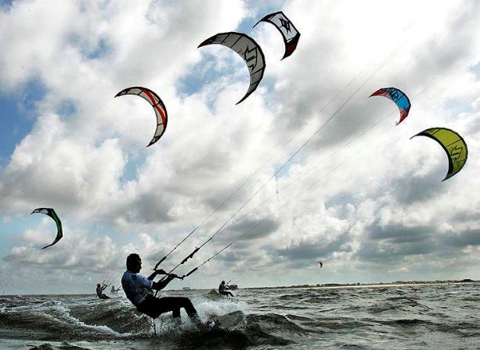
Engineering Design (And Capstone Design)
starts with a NEED.
CLEARLY DEFINED,
WELL UNDERSTOOD
AMBIGUOUS
PREVIOUSLY UNDEFINED
Notes:
Engineering design is the process of devising a system, component, or process to meet desired needs. It is a decision-making process (often iterative), in which the basic science and mathematics and engineering sciences are applied to convert resources optimally to meet a stated objective. Among the fundamental elements of the design process are the establishment of objectives and criteria, synthesis, analysis, construction, testing and evaluation. The engineering design component of a curriculum must include most of the following features: development of student creativity, use of open-ended problems, development and use of modern design theory and methodology, formulation of design problem statements and specification, consideration of alternative solutions, feasibility considerations, production processes, concurrent engineering design, and detailed system description. Further it is essential to include a variety of realistic constraints, such as economic factors, safety, reliability, aesthetics, ethics and social impact." Elsewhere in the ABET criteria for accreditation, they stress the use of teams in solving problems and performing designs.

Slide 6
https://engineeringunleashed.com/mindset-matters.aspx

Slide 7
“ENTREPRENEURIAL MINDSET”
KEEN: a network of universities committed to cultivating the entrepreneurial mindset in engineering students.
KEEN = [Kern Entrepreneurial Engineering Network.]
https://engineeringunleashed.com/mindset-matters.aspx
Elements of an Entrepreneurial Mindset:
CURIOSITY- helps individuals investigate and understand a rapidly changing world.
CONNECTIONS-Making connections between unrelated areas often provides innovative solutions.
CREATING VALUE – “Innovative solutions are most meaningful when they create extraordinary value for others.”
– KEEN Website http://www.keennetwork.org/
Notes:
Kern Entrepreneurial Engineering Network.
Mindset is a set of attitudes and dispositions
Entrepreneurship is the process of designing a new business, i.e. a startup company offering a product, process or service. (Wikipedia)
Question for the students Why is the entrepreneurial mindset important?

Slide 8
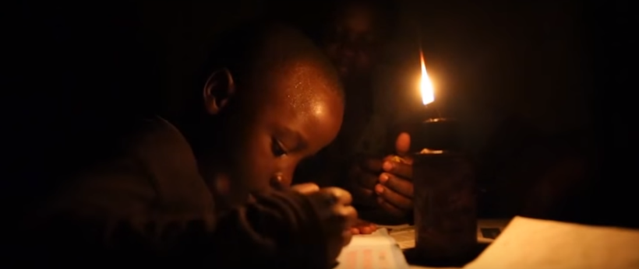
CREATING VALUE: What is the real need here?
Using Kerosene lamps for light in the developing world can be dangerous and expensive.
Initial Problem Statement: Build a cheap solar-powered lantern
Problems:
solar cells and batteries are expensive
Batteries are hard to replace; their disposal has an environmental impact
New Problem Statement: Provide off-grid light to replace kerosene lamps

Slide 9
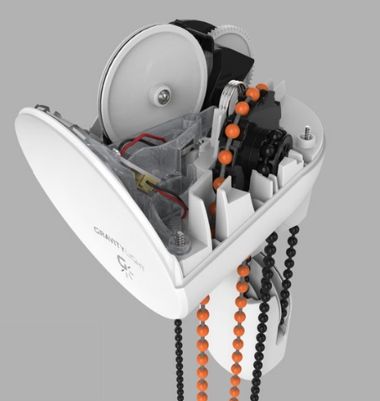
The GravityLight
https://www.shell.com/make-the-future/cleaner-energy-for-homes/turning-gravity-into-light.html
GravityLight uses the kinetic energy from a 12kg bag of sand, descending about 1mm per second.
This powers a drive sprocket (low speed/high torque)
A polymer gear train provides a high speed, low torque output that drives a DC generator to power an LED bulb.
The LED bulb is 6 times brighter than a kerosene lamp
30 minutes of light for each time the bag is raised.
https://www.npr.org/2013/01/18/169708753/inventors-design-lamp-powered-entirely-by-gravity
Notes:
Well, currently, the costings for the first prototype at about 5,000 units is about $6.50. But we've got various - a couple of bearings in there that we hope to not need in the future.

Slide 10
Focusing on needs,
not products or technical solutions, can produce
innovative solutions
Try not to jump to the answer!

Slide 11
How do I find opportunities to create value? Cultivate CURIOSITY; make CONNECTIONS
Develop a habit of learning about the world around you
news, technical subscription services (ASME Tech Briefs)
Talk to People
Ask questions, learn other viewpoints.
Personal Experience
Travel, Work, Play, Reflection.
Research
Trends and new work in my technical area?
My society? The world at large?
Serendipity: the occurrence of events by chance in a happy or beneficial way

Slide 12
CURIOSITY
What you don’t know that you don’t know
What you know you don’t know.
What you know

Slide 13
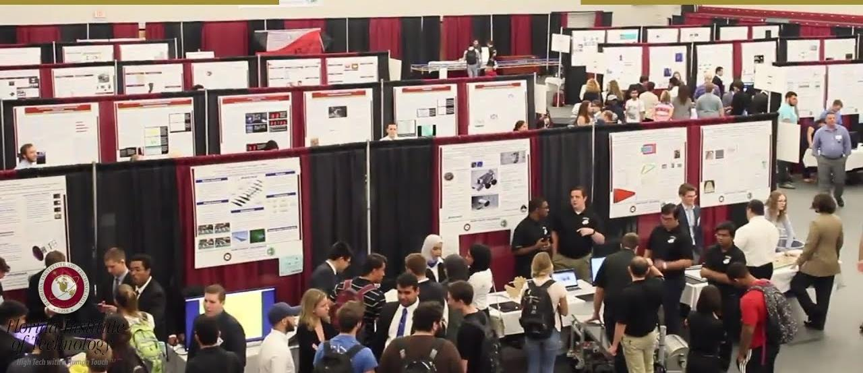
2. Defining Capstone topic areas
Exercising curiosity, making connections,
and looking for chances to create value

Slide 14
Notional Course Flow
Initial Class Phase:
Intro material, define topic areas (Week 1-4)
Students Teams are formed (Week 5)
Second Phase: Working in Teams
Sprint 1: Design Thinking (Week 6-8)
Sprint 2: Preliminary proposal (Week 8-10)
Sprint 3: Refining the Proposal (Week 11-14)
Sprint 4: Presentations & Feedback (Week 15-16)
Teams start with a topic area: Week 6
and end with a proposal: Week 16

Slide 15
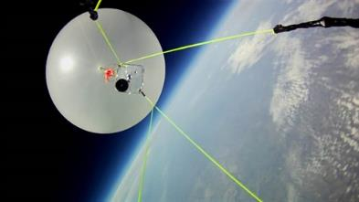
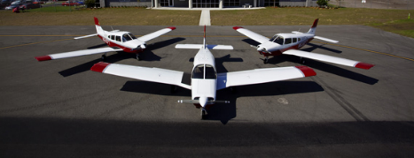
Capstone Topic Areas
?
CLEARLY DEFINED,
WELL UNDERSTOOD
INDUSTRY / UNIVERSITY
COMMITMENT, FUNDING
AMBIGUOUS
CURRENTLY
UNDEFINED:
Generated
in next 2-4 weeks
???
Notes:
Engineering design is the process of devising a system, component, or process to meet desired needs. It is a decision-making process (often iterative), in which the basic science and mathematics and engineering sciences are applied to convert resources optimally to meet a stated objective. Among the fundamental elements of the design process are the establishment of objectives and criteria, synthesis, analysis, construction, testing and evaluation. The engineering design component of a curriculum must include most of the following features: development of student creativity, use of open-ended problems, development and use of modern design theory and methodology, formulation of design problem statements and specification, consideration of alternative solutions, feasibility considerations, production processes, concurrent engineering design, and detailed system description. Further it is essential to include a variety of realistic constraints, such as economic factors, safety, reliability, aesthetics, ethics and social impact." Elsewhere in the ABET criteria for accreditation, they stress the use of teams in solving problems and performing designs.

Slide 16
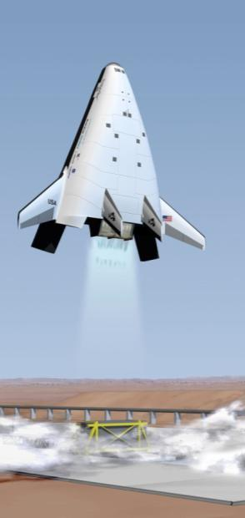
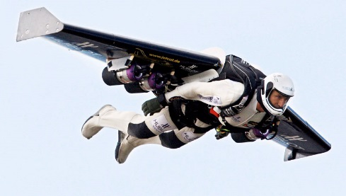
Capstone Project Constraints /Limitations
Available Funding
Existing state-of-the-art
Team capacity
Skills/Growth potential
Time available to complete the effort
Three semesters
xx hours per week
External support: advisors, etc
Safety
Rules Regulations, and Ethics
Course Requirements
and Instructor Constraints

Slide 17
Course Requirements /Constraints
An Aerospace Capstone project will include:
A clear set of objectives and requirements
A design
Analysis
A physical product that is fabricated and tested
The fabricated product may be a “proof of concept” or a prototype
Topics need to have an aerospace theme or application

Slide 18
WHERE GOOD IDEAS COME FROM
https://www.youtube.com/watch?v=NugRZGDbPFU

Slide 19
Ideas and connections:
Innovation thrives in collaborative networks where opportunities for serendipitous connections exist.
Good ideas spill through connected “liquid” networks of individuals.
https://www.youtube.com/watch?v=NugRZGDbPFU

Slide 20
Making CONNECTIONS
The adjacent possible: innovations come from combinations of what’s already available.
“Exaptation” –one thing is used for something different
Feathers for warmth become feathers for flight
Grape presses for wine become printing presses
Error: How can a mistake or problem become a solution?
Evolutionary Improvement: How can I make an existing idea better?
Mashups: take two ideas and put them together.
Biomimicry: What would Mother Nature do?

Slide 21
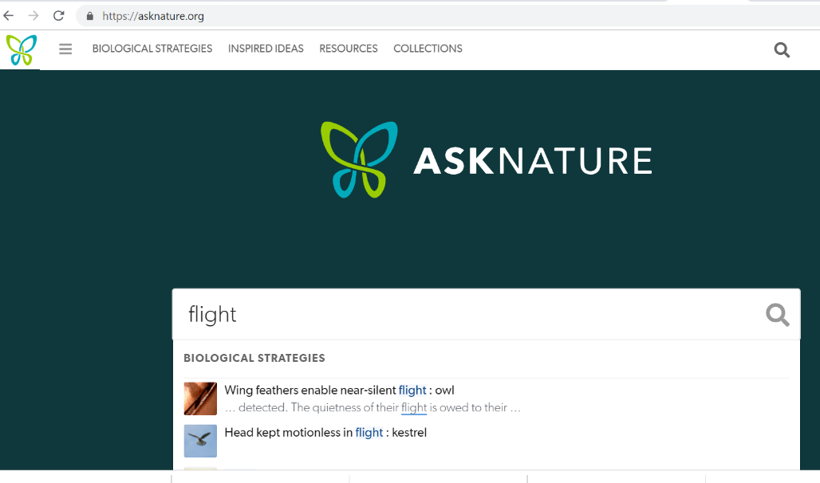
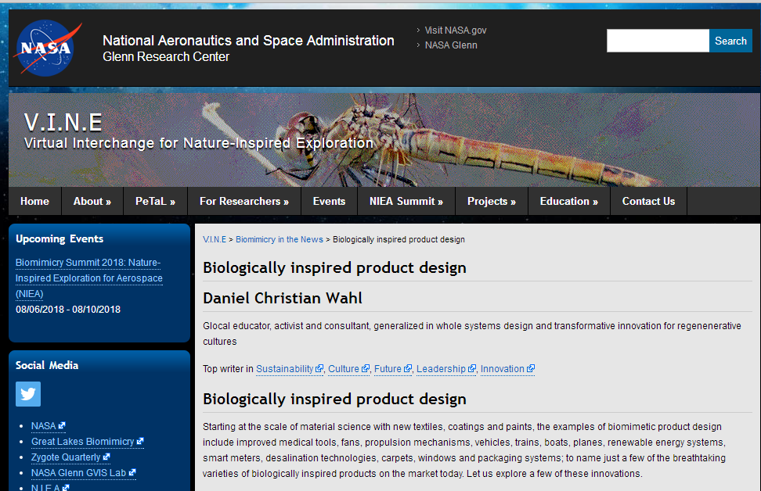
Biomimicry and Aerospace
Biomimicry database
https://asknature.org/
https://www.grc.nasa.gov/vine/2017/biologically-inspired-product-design/

Slide 22
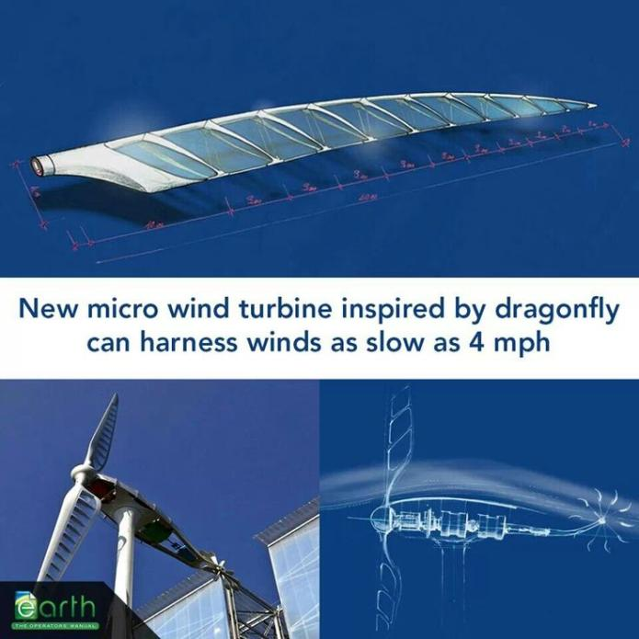
Ideas…Biomimicry, Aerospace Structures, and Additive manufacturing.
Right angles are rarely seen in nature, but our structures have them because of our traditional fabrication techniques. Can we do better?
Siemens has given Florida Tech access to powerful software… how can use it in our design processes?

Slide 23
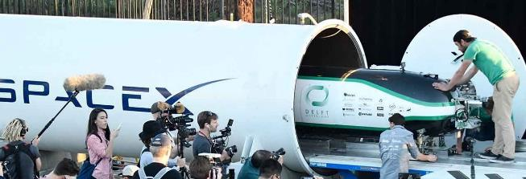
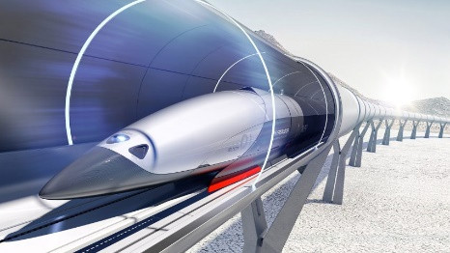
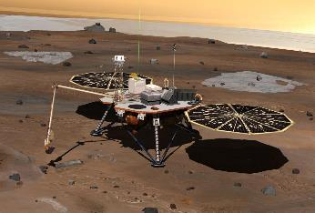
Draw inspiration from competitions, even if the team does not formally compete.
Even if the timing or scope of a competition isn’t an ideal match for a senior design project, a competition’s requirements can be used to define a project.
SpaceX Hyperloop Pod Competition (a student team is being formed at FIT)
https://www.youtube.com/watch?time_continue=30&v=AO0sPME3j2s
https://www.spacex.com/hyperloop
2018 NASA BIG Idea challenge: Designing solar for Mars http://bigidea.nianet.org/ Goal: to design and analyze innovations in large solar power system on the surface of Mars.
https://www.nasa.gov/content/nasa-glenns-2018-2019-university-student-design-challenge-aeronautics

Slide 24
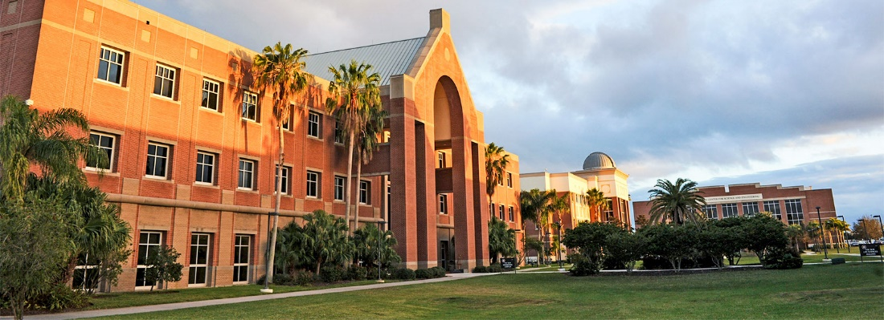
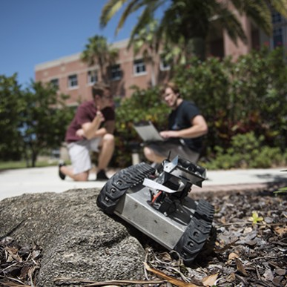
Aerospace Experiments and “Making” for education…
How could we enhance learning at Florida tech by creating new demonstrations, lab experiments and test capabilities?
New design projects in the curriculum?
New opportunities for students to create value in our makerspaces and HSDC?

Slide 25
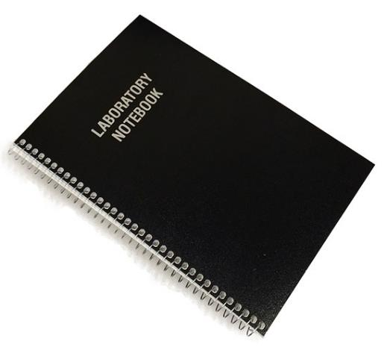
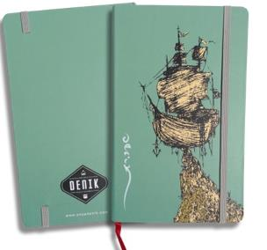
Personal Design Notebook: a tool to cultivate connections and capture “slow hunches”
Not required this year, but encouraged
Physical Characteristics:
Lightweight/portable, of reasonable size
Pages are bound into the book-no ring binders. (You can add graphs, etc. with glue or tape- just identify when the material was added).
Electronic Notebook Option
Evernote, others?

Slide 26
Personal Design Notebook: What to write?
Brainstorming/ Weird ideas
Sketches/ hand calculations encouraged!
Project Status: Victories and Challenges
Forward work / To-Do lists
Lessons learned
Useful Technical References
Hours worked and what accomplished

Slide 27
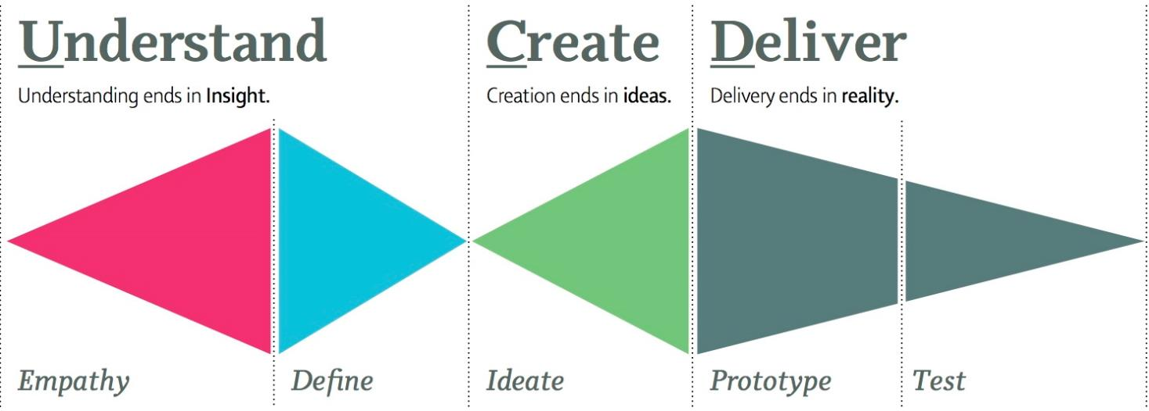
Idea Creation: think broadly, then focus
Junior Design: pick a topic
MAE 4291: Design a solution
MAE 4292: Build and test
Design involves iteration,
so steps will be repeated at different levels of detail

Slide 28
Topic Evaluation: Evaluation Phase
When evaluating topics, consider the following:
Does the topic relate to a real need or problem?
Can I imagine completing a project in this area within the constraints of capstone design?
How likely would someone be to fund this topic?
What level of support/expertise is available to support a senior design team?
Who might be a good faculty advisor?
“Define the problem so success is possible.” – Kimberly Demoret
Notes:
Before you unleash a talented (and expensive) design team on a project, make sure you are solving the right (best) problem.
In large company- “scrub” your requirements.
Senior Design will include more details here.
In a small company- make sure you’re making things someone else wants to buy.
XX% of all businesses fail because there isn’t a market for their cool new project.

Slide 29
Ungraded Survey: Societal Needs and Topics of Interest (due Friday)
Identify a societal need, issue or opportunity that you personally care about.
It does not have to relate to aerospace.
Identify a societal need, issue, or opportunity where aerospace engineering MIGHT be able to add value.
3. Identify a Capstone topic area of interest
associated with a specific societal need?
associated with a specific technology?
a very specific project?

Slide 30
Capstone Project Ideas Assignment (due end of week 2)
For full credit, identify at least 3 sources of information that you used to complete the assignment.
(Interviews, web sites, books, etc).
Part 1: Describe the Project idea.
What do you like; what are the challenges; do you want to brief it to the class?
Part 2: Consider Potential Customers.
Who are the potential customers? How does this help them?
See Canvas for Details

Slide 31
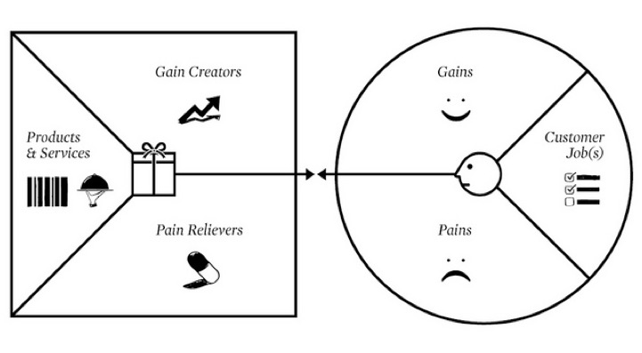
CREATING VALUE: The Value Proposition Canvas
To create value for others, you need to understand their needs.
6-min video on “Painstorming for opportunity recognition: https://www.youtube.com/watch?v=SCgoI2cPK-E
Osterwalder, A., Y. Pigneur, G. Bernanda, A. Smith, Value Proposition Design: How to create Products and services Customers want. Wiley, https://strategyzer.com/canvas

Slide 32
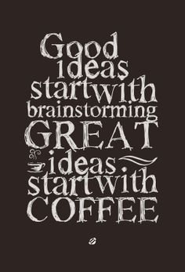
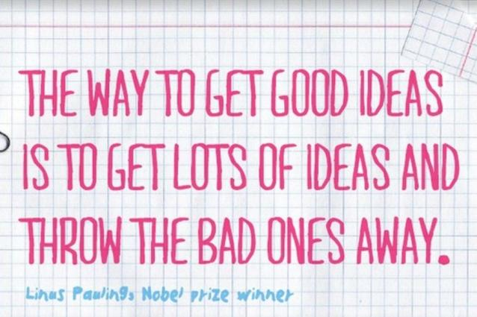
Idea Creation Mixer next Monday
Abandon judgment – anything goes at this phase.
Two or more brains are better than one… but too large a group is not optimal.
The idea is to break out of normal ways of thinking, so avoid criticizing or praising ideas. Judgment and analysis comes later.

Slide 33
Disclaimers:
Not all proposed topics will be approved
Not every student will get their first choice of project
Typical team has eight Aero Engineering students
If you propose a topic and it survives the down select, you will be part of that team.
You may not like everyone on your team
If I need to know something important, tell me before teams are formed (restraining order, Title IX issue, family vendetta etc)
In some cases:
new teams are formed late in the cycle
Some teams have been dissolved after Junior Design

Slide 34
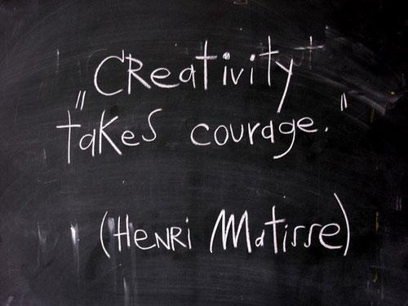
QUESTIONS?

Slide 35
The Adjacent Possible
Adjacent possible innovations come from the first-order combination of what’s already available (“spare parts”).
The inventions whose raw material is not available are ahead of their time and fail to materialize.
YouTube succeeded in 2005, but it would have failed if launched in 1995.
A good solution combines what’s available to solve the problem.
Notes:
The Adjacent Possible
The adjacent possible innovations come from the first-order combination of what’s already available (“spare parts”).
The inventions whose raw material is not available are ahead of their time and fail to materialize.
YouTube succeeded in 2005, it would have failed, if launched, in 1995.
The environments where the adjacent possible can be explored lead to good innovation.
Challenging problems don’t define their adjacent possible in a clear way. A good solution combines what’s available to solve the problem.

