Slide 1
Building Resilience in Research
Program Name
Date

Slide 2
Workshop learning objectives
Describe the importance of resilience skills for achieving research goals, including resilience skills students already use.
Use the technique of assertiveness to think ahead and develop unexpected and creative solutions to problems.
Practice assertiveness using role play in at least two situations, and provide feedback for peers.
Reflect on personal strengths and challenges in self advocacy, and a support system for continued growth and success.
Identify growth areas related to resilience and a plan for self-directed learning and practice in these areas.

Slide 3
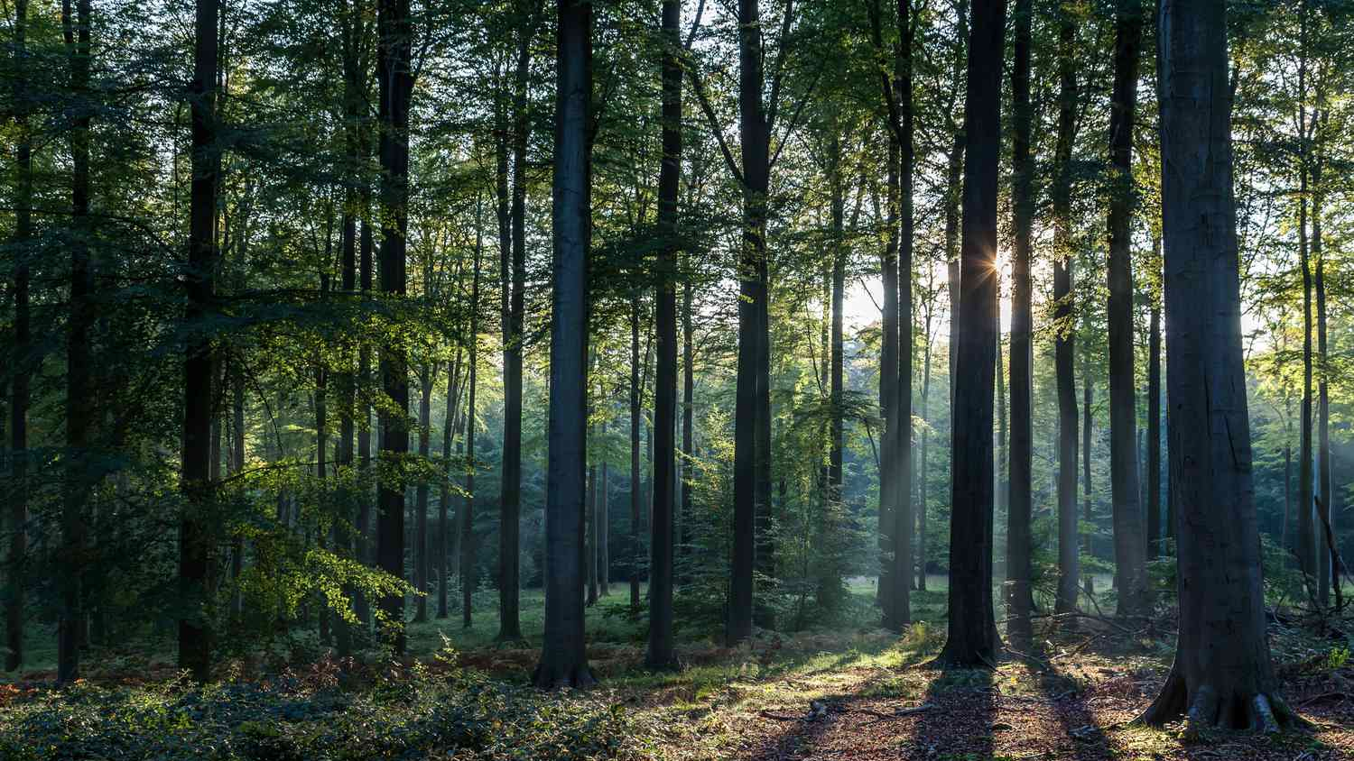
How do we connect resilience to success?
`
What superpowers do you already use on a daily basis?
What superpowers do you use when the going gets really tough? (Ex. do you persist?, do you adapt?, do you seek support? And, how?)
What superpowers do you want to develop and why?
Notes:
Facilitator:
“Before we watch the introductory video for this workshop, let’s talk about what “superpowers” you possess right now. It is important to inventory our wisdom to intentionally leverage our strengths. Think about a tough situation you navigated, and what you did to overcome the challenge you were faced with. Were there some key behaviors you can identify that you used to work through the challenge? In other words, what did you do to be resilient and succeed—we want to identify and practice more of those behaviors!”
Give students a minute to think, and then ask them to share their stories with a partner if they feel comfortable. Once students talk through their challenge and “superpower” with a partner, collect the “superpower” ideas from students (on white board for a small group, Poll Everywhere, jam board, or Mentimeter for larger groups). Briefly discuss common themes. Likely themes relate to being willing to learn, being adaptable, being persistent over time even when the going is tough, believing in themselves, leaning on a support system (parents, friends, spiritual leaders).
“An entrepreneurial mindset includes building skills within ourselves to be comfortable with the unknown, with difficult conversations, with not being satisfied without answers, with being creative in obtaining information, with persisting in touch situations, or with how to solve a complex problem. We’ll watch the video for this workshop now, which will introduce some steps you can take to practice building these skills, or “superpowers” to create value within yourself, and for your stakeholders. As you watch the video, consider your own experiences—past, current, and future—and how you might apply these ideas.”
Watch the introductory video for this workshop.
[10 min, including video]

Slide 4
Knowing our tendencies allows us to leverage and build up our resilience behaviors.
What are some things that could make it more challenging for you to be assertive?
Are there things that could make it easier for you?
Notes:
Facilitator:
“From the video, Joey found himself needing to advocate for himself so that he could succeed in his research. Joey thinks through the various ways he could respond. Take a minute to think about a recent situation that was hard, or a current situation you’re facing now, that might benefit from assertiveness.”
Give students a minute to think, then have students share with a partner. If they feel comfortable, have some groups report out. Depending on the intimacy of the group, use an anonymous polling software like Poll Everywhere to solicit responses if anonymity is needed.
For larger groups, it may be necessary to use an electronic polling software like Poll Everywhere to collect student answers. Small groups can share ideas in round-table style if the students feel comfortable doing so.
“Now, with your situation, let’s think if there are some things that could make it more challenging for you to be assertive. Are there things that could make it easier? These could be things like lack of experience or a tendency to shy away from conflict that could make it harder, and practicing with a friend first or keeping the bigger goal/picture in mind that could make it easier. You can think back to times you have persisted or have learned from failure to help you recognize things that make it easier or harder for you.
Have students share their ideas again with a partner. This time the sharing could be just for a minute.
“To help Joey be able to use assertiveness for self-advocacy, one resilience superpower, Joey remembers practicing with his friend, Jorge. In doing so, earned his “assertive superpower” cloak. Assertiveness is something that we can think about and talk about, but it can still be really hard to do. The way to be able to do this is to prepare and practice, so we are going to do some practice. I will introduce a scenario and then you will come up with the actual words you might use to be assertive in that situation. We know that it can feel awkward and uncomfortable to do this, which is why we are practicing together here. We really want people to try to come up with some words they would use and try saying them out loud.”
"We know that role-play may feel silly at first, but is a helpful tool for practicing a behavior we want to master. Are we willing to give it a go? Let’s practice like Joey did, so we can work to earn our self-advocacy assertive ‘superpower’.”
[5 min]

Slide 5
Scenario 1: Assertiveness with a colleague
You and a lab partner have a group meeting presentation to give at the end of the week. You also have another project and are very busy. You meet with your partner to go over the presentation and the two of you realize you need to redo some of the slides and add additional slides. Your partner tells you they cannot do much and that you will need you to do the work.
Notes:
Facilitator:
“This scenario is like Joey’s, but you will need to come up with the actual words you would say to your lab partner. First, with a partner, pick who will be the person and who will be the lab partner. Don’t worry, you’ll get to switch.”
“The first thing to do when thinking about the words you’ll say is to be sure that you get in there a “clear ask”. That means to be specific about what you are asking for.”
“The next thing is to come up with a few sentences you would use to express your clear ask to your colleague in an assertive (not aggressive, but also not passive) way. If you want to jot down a few bullet points, feel free to take a minute to do so.”
“For the receiver, practice acknowledging what the other person is saying and thanking them for sharing their thoughts. This will help us practice empathy, and help the person feel more confident in saying these words.”
Now have students start practicing with their partner. Walk through the room and listen for students saying the actual words, vs. what they “would say”. Students will tend to do that instead of speaking directly to the other person. If needed, stop the role play and remind students to say the actual words.
After 3-4 minutes have passed, ask students to reverse the roles, if they haven’t already. If some teams finish up before others, have them think of another scenario or use their own scenario that they identified before the video to practice.
Ask if there is a team that would be willing to share with the class their conversation.
If the team is willing, ask for constructive feedback on the exchange—make sure that the presenting students are acknowledged for being vulnerable and thanked for sharing. If you’re unsure students will provide helpful feedback, you can decide to not open it up to the class and offer feedback yourself—did they give a clear ask and did the other person acknowledge—and thank them and move on.
[10 min]

Slide 6
Scenario 2: Assertiveness with a supervisor
Your supervisor or a stakeholder asks you to take on a large project that is exciting, but you haven’t done anything like this before and you are not sure you can do it to the level you’d want to in the time frame expected—after all, you are an undergraduate with a full class, athletics, and volunteer schedule.
Notes:
Facilitator:
“Here’s where things get harder, so we need to be even more creative in how we might respond. You might, in this role play, wish to practice responding in multiple ways. We have the time and we’re all in this together, so let’s practice!”
“Take a minute to think about some possible clear asks. This is where we need to be creative, possibly thinking about resources, bringing other people into or leveraging stakeholders in the project, or thinking about interim or phased solutions. If it helps, you can brainstorm a possible scenario that actually could be feasible based on your current research, or consider a real situation you’ve encountered or heard about.”
“Pick who will be the student and who will be the supervisor/stakeholder, and go ahead and practice saying the words. Make sure you aren’t describing what you would do, but actually saying words of what you could say in this situation.”
Give students time to role play, and be sure that they’re saying the words, and that they switch roles. Walk around and offer support and ideas as needed.
Ask if a team wants to demonstrate their conversation out loud to the class. If they are comfortable, allow positive feedback, and be sure to step in if it isn’t positive.
Then ask students to reflect:
“What was that like to come up with the words and to try saying them? What can you do to deal with fears around being assertive, or who can you turn to for support and to practice assertiveness?”
Solicit a few responses
[10 minutes]

Slide 7
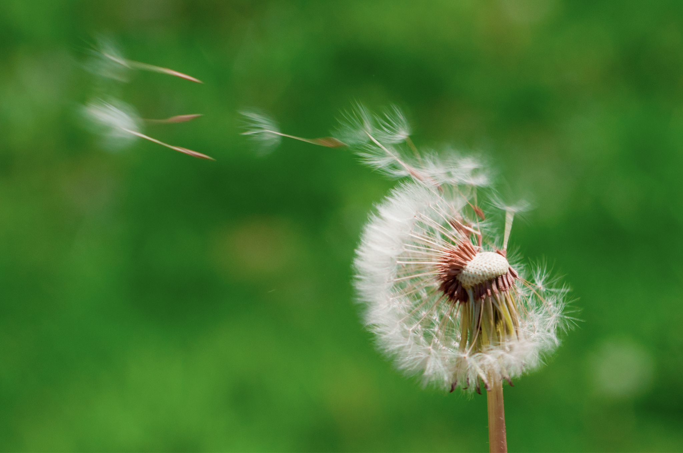
How does the superpower of persistence contribute to success?
When have you been persistent? How?
Notes:
Facilitator:
“Now that we’ve practiced the superpower of assertiveness, let’s explore another important superpower of resilience: persistence over time.”
“Before we watch a video about persistence, let’s think about a time you were persistent. It could be research-related, or it may not be. Again, it is important to reflect on our accomplishments so we can determine areas of strength and growth. Think about things you do on a regular basis to persist even when the going gets tough. We want to identify what you did to persist and succeed so we can look for opportunities to practice persistence in more areas of your work.”
Give students a minute to think, and then ask them to share their stories with a partner if they feel comfortable. Once students talk through their persistence example with a partner, collect the persistence examples from students (on white board for a small group, Poll Everywhere, jam board, or Mentimeter for larger groups). Briefly discuss common themes. Likely themes relate to working regularly–showing up–even when they didn’t feel like it, seeking to learn new skills over and over for a daunting project, or intentionally seeking to fail early and often, etc.
Now show the video: https://www.ted.com/talks/william_kamkwamba_how_i_harnessed_the_wind.
[10 min, including the video]

Slide 8
How can we upgrade our persistence superpower?
Notes:
Facilitator:
“What inspires you about William Kamkwamba? At age 14, in poverty and famine, he used the resources he had, and persisted in building a windmill to power his family's home, through the jeers of doubters, and regardless of the fact that he was illiterate. Make a list of ways you have been resourceful in the past week, and how that worked. This is where we want to celebrate our habits where we perhaps channeled Kamkwamba, so we can be aware of our capabilities.”
Give students a minute to think and jot down their ideas. They would be welcome to share ideas with a peer if they want, depending on the energy of the workshop at this point.
“Now, think to a problem you’re working through. You may wish to think about your research and identify something you’re working on that is particularly perplexing. Thinking back to Kamkwamba’s consistent grit, what are some ways you might reinforce the persistence habits you identified as exhibiting over the past week, and what are some ways you could start being more persistent, more resourceful, more accountable to your goals over the next couple of weeks?
[5 min]

Slide 9
Discussion–Your resilience charge
Think about something that you would like to change that requires assertiveness. What could you practice to build value within yourself?
What are some steps you could take in the next weeks to begin to prepare for and/or tackle that? Who or what can you connect with?
What are some other resilience superpowers that you want to develop? How could you practice building them?
Notes:
Wrap up the workshop with student discussion of these questions, and have the students fill out the worksheet in their slidedeck/handout to identify resilient superpower ideas and a plan for working on them. Of course, also take time to discuss (as you have time) any other questions students have.
Facilitator:
“Resilient researchers work on developing many other skills such as adaptability, resourcefulness, and confidence. They have positive and realistic outlooks and have a mission, not letting negative circumstances determine the outcome. And resilient researchers also know they don’t have to go it alone - developing a support system of friends and colleagues will also help in overcoming obstacles.”
“Other resilience superpowers could be things like taking time to brainstorm creative solutions even when it seems there’s only one obvious bad choice, or journaling to understand positive aspects of challenges, or many others. What are ideas you have? How could you practice these superpowers today/tomorrow/this week so that you have them at your disposal when you need them?”
[10 minutes]

