Slide 1
EM@FSE EM Classroom Assessment Best Practices: Robust EM Assessment Examples
Gary Lichtenstein, Ed.D.
Director of Program Effectiveness, EM@FSE
Academic & Student Affairs
Arizona State University
May 17 2020rev

Slide 2
The EM@FSE Framework integrates Entrepreneurial Mindset as a vital outcome of students’ degree programs.
THE EM@FSE FRAMEWORK

Slide 3
EM@FSE Indicators

Slide 4
EM Classroom Assessment Best Practices for Robust EM Assessment
EM@FSE Classroom Assessment Best Practices
1. The assessment requires students to demonstrate curiosity, make connections, and/or create value.
2. Assess the EM@FSE 2.0 indicators
3. Assess each indicator EM@FSE indicator assessed explicitly—identify it using the language of the indicator and/or the letter (e.g., EM@FSE.a)
4. Assess each EM@FSE indicator individually –One score per indicator as opposed to one score for multiple indicators at once
5. Each assessment indicates a level of performance at, above, and below proficient
6. When possible, assess EM indicators multiple times during the term—at least 2x, up to 4x)

Slide 5
EM@FSE Assessment Best Practice: Example #1
By Dr. Timothy Takahashi
AEE 468, Aircraft Systems Design
Aerospace Engineering
SEMTE
Assignment objectives are assessed using EM@FSE indicators explicitly and individually—Performance is rated.

Slide 6
EM Assessment Before Assessment Lab
Excerpt of grading rubric for TA/Grader
Exit Criteria: Have they shown requirements?
Instructor Supplied (# pax, basic mission conops)
EXEC / GOOD / FAIR / POOR
Customer derived (evidence of outside research)
EXEC / GOOD / FAIR / POOR
14 CFR 25 – Performance & 14 CFR 91/121 Ops
EXEC / GOOD / FAIR / POOR
14 CFR 25 – Structural Design
EXEC / GOOD / FAIR / POOR
14 CFR 25 – Interior
EXEC / GOOD / FAIR / POOR
In this example, the Exit Criteria cover EM, but not in an obvious way and not linked to EM@FSE indicators.

Slide 7
EM Assessment AFTER Assessment Lab
Exit Criteria: Have they shown requirements?
EM@FSE – Can the team define market opportunities? - # pax, conops EXEC / GOOD / FAIR / POOR
i.e. Evidence of market research for more than 1 airline EXEC / GOOD / FAIR / POOR
i.e. Evidence of 14 CFR 25, 91 & 191 operations req. EXEC / GOOD / FAIR / POOR
i.e. Evidence of 14 CFR 25 structural design req. EXEC / GOOD / FAIR / POOR
i.e. Evidence of 14 CFR 25 – Interior req. EXEC / GOOD / FAIR / POOR
Note that the outcomes are the same as BEFORE, but now the CFR regs provide evidence of an EM@FSE indicator. No change in the assignment requirements, but now the link to EM@FSE is explicit.
See Next Slide

Slide 8
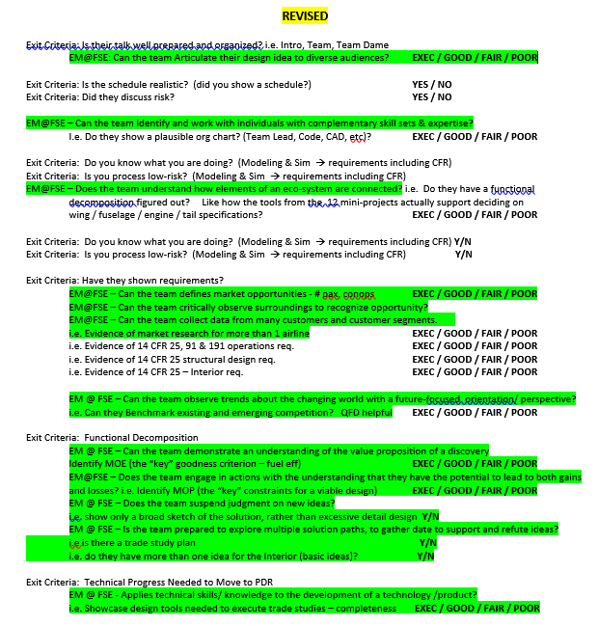
EM Assessment AFTER Assessment Lab
The prior example reflects one of many assignment outcomes re-framed to highlight EM@FSE indicators.

Slide 9
EM@FSE Assessment Best Practice: Example #2
By Dr. Steve Trimble
MEE 488/489, Mechanical Engineering Design Capstone
Mechanical Engineering
SEMTE
Assignment objectives are assessed using EM@FSE indicators explicitly and individually—Performance is rated.
Use of peer grading relieves the burden of grading and reinforces to students the value of providing constructive, discerning feedback to colleagues.

Slide 10
EM@FSE Checklist Assignment (Capstone)
This is an excerpt of one team’s responses.
6. EM Checklist EM@FSE 2.0 Indicators A-Q
A) Worksheet 1 does accurately show the curiosity of the team and which societal needs the team is most interested in. In terms of Grand Challenges, the team identified the set of challenges society is faced with and linked them to our societal needs. The team identified reducing carbon emissions, which can be done through a variety of ways that the team evaluated.
B) The team explored existing products to increase efficiency of a bicycle. After doing so, each member created their own designs and compared them.
C) The team documented research into customer needs and was heavily considered when choosing the final design.
D) There were multiple concepts considered that completely changed how a traditional bike drivetrain operates. In doing so, it sufficiently shows there were a variety of creative ideas that were assessed without judgement.
[Narrative paragraphs continued for all a-q indicators]
The assignment was for each team to use the EM@FSE Indicators Explained document to explain how it addressed each EM@FSE a-q indicator while developing its Capstone innovation.

Slide 11
You can imagine the time it would take to grade each team’s 17 responses. Plus, creating a meaningful performance rubric would be a challenge. Then assessing the extent to which a response met rubric criterion would require a lot of judgement and time.
Peer assessment, on the other hand, with built-in rigor and accountability, reduces the burden of grading for faculty and graders, reinforces the lesson objectives and bolsters students’ professional skills.
See next slide
17 Indicators p/Team
6. EM Checklist EM@FSE 2.0 Indicators A-Q
A) Worksheet 1 does accurately show the curiosity of the team and which societal needs the team is most interested in. In terms of Grand Challenges, the team identified the set of challenges society is faced with and linked them to our societal needs. The team identified reducing carbon emissions, which can be done through a variety of ways that the team evaluated.
B) The team explored existing products to increase efficiency of a bicycle. After doing so, each member created their own designs and compared them.
C) The team documented research into customer needs and was heavily considered when choosing the final design.
D) There were multiple concepts considered that completely changed how a traditional bike drivetrain operates. In doing so, it sufficiently shows there were a variety of creative ideas that were assessed without judgement.
X
20 Teams

Slide 12
Peer Review Rigor & Accountability
The Peer Review Process
Teams submit their EM@FSE reflections in Excel, to a Googledoc, for example.
Faculty assign a Review Team to review the Original Team’s responses.
The Review Team uses a rubric to assign a score to each response and is encouraged to provide comments.
When completed, scores and comments are uploaded into Excel in columns next to the Original Team’s responses.
The Original Team reads Review Team responses and uses another rubric to assess the value of those comments, entering scores in a third Excel column.
Faculty (or TA/Grader) copies the 3 response columns (possibly using a Macro) and creates a Master sheet. From there scores and grades to the Original Teams and Review Teams can be calculated and assigned.

Slide 13
Peer Review Rigor
Review Team Rubric
Score | Criterion
3 | Narrative aligns with the indicator extensively.
2 | Narrative aligns with indicator moderately.
1 | Narrative aligns with indicator somewhat.
0 | Narrative does not address indicator.
Rigor is built-in through the use of a simple, 4-point Review Team Rubric. The Review Team uses the rubric to score the Original Team’s responses. Note comments are not required. But the Original Team will assess the value of the feedback based on Reviewer Team comments received (see next slide). This process is intended to prompt reviewers to provide substantive, thoughtful feedback.

Slide 14
Peer Review Accountability
Original Team’s Rubric
Score | Criterion
3 | Comment helped me learn and/or caused me to reflect.
2 | Comment confirms that our team’s narrative aligns with the indicator.
1 | Comment does not contribute to our understanding.
0 | No comment provided
Accountability is built-in through the use of another simple, 4-point rubric. After receiving Review Team’s results, the Original Team evaluates the comment related to each indicator. This process is intended to provide accountability for the Review Team to provide substantive, thoughtful feedback.

Slide 15
EM@FSE Assessment Best Practice: Example #3
By Dr. Doug Sandy
SER 401, Computing Capstone I
Software Engineering
CIDSE
EM@FSE indicators are assessed individually and explicitly—multiple times during the term.

Slide 16
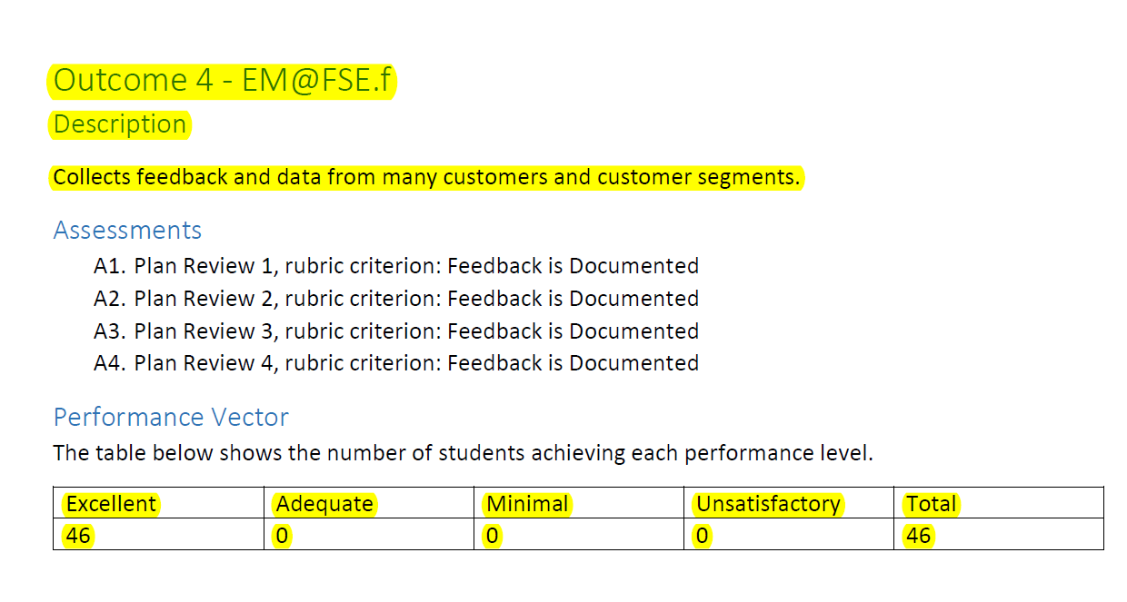
EM Assessment Multiple Times/Term, Performance is rated.
This is an excerpt from a faculty’s end-semester report on EM@FSE results throughout the term.
EM@FSE(f) was assessed 4x during the term.
These were the performance levels

Slide 17
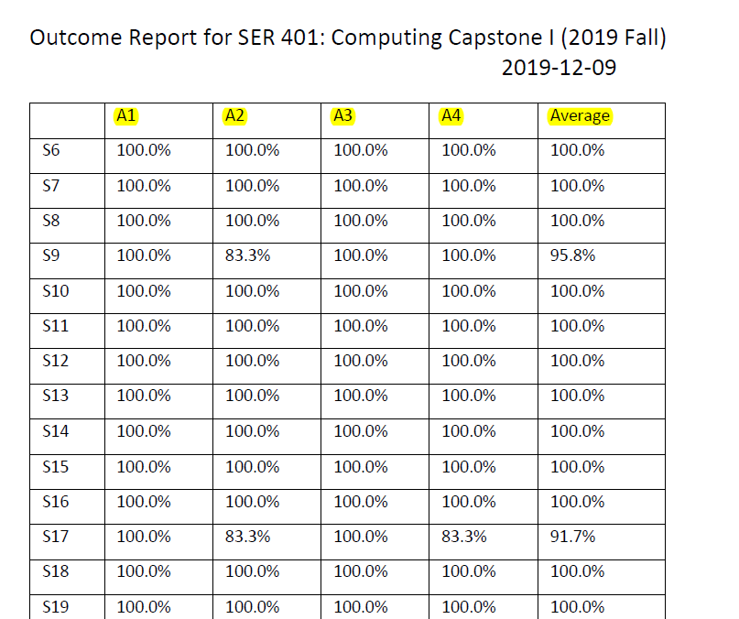
EM Assessment Multiple Times/Term, Performance is rated.
Each of 46 student scores is listed, along with semester average on this indicator.
The software tool that makes this grading efficient and automated will be rolled out to all FSE EM faculty in Fall 2020.

Slide 18
EM Robust: Example #4
By Dr. Darryl Morrell
EGR 401, Professional Design Project I
Aerospace Engineering
TPS
Assignment deliverables are assessed using EM@FSE indicators and they are assessed one at a time. But indicators are translated into assignment-specific criteria and connection to actual indicators might not be obvious to students.
In order to be a best practice, 1) the reworded indicator must clearly align with the EM@FSE indicator, AND 2) the EM@FSE indicator must be explicitly identified to students (i.e. EM@FSE.h)

Slide 19
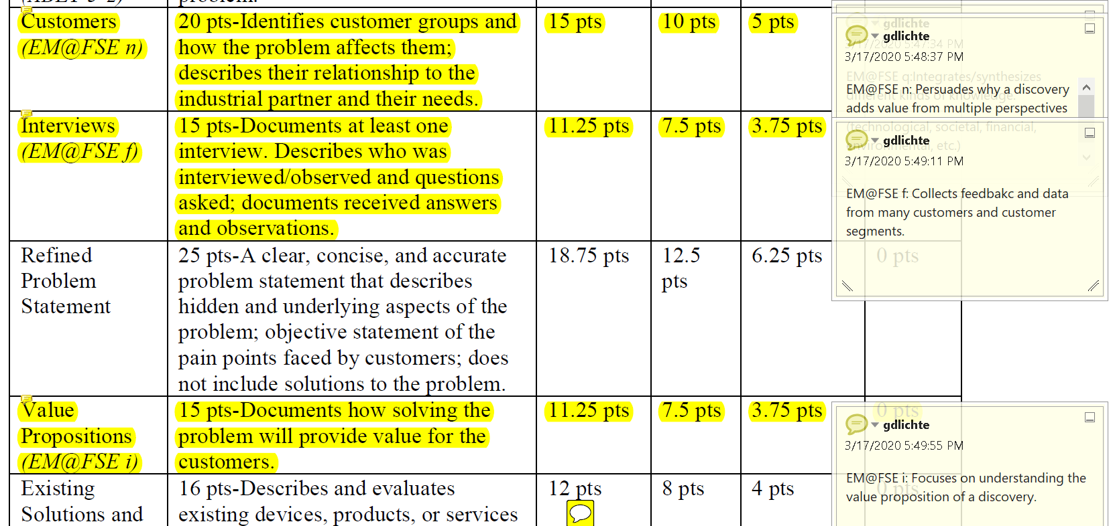
EM Robust: Example# 4

Slide 20
Bonus Material: Six Qualities of Effective Assessment
Meaningful—Learning Objectives are relevant and valuable relative to the goals of the course.
Valid/Fair—you assess Learning Objectives, which you have taught.
Reliable--you (and your graders) apply the same criteria in assessing every student’s exam/deliverable.
Efficient--grading doesn’t take excessive time or energy.
Feedback is speedy and actionable.
The assessment experience provides students an opportunity to grow.

Slide 21
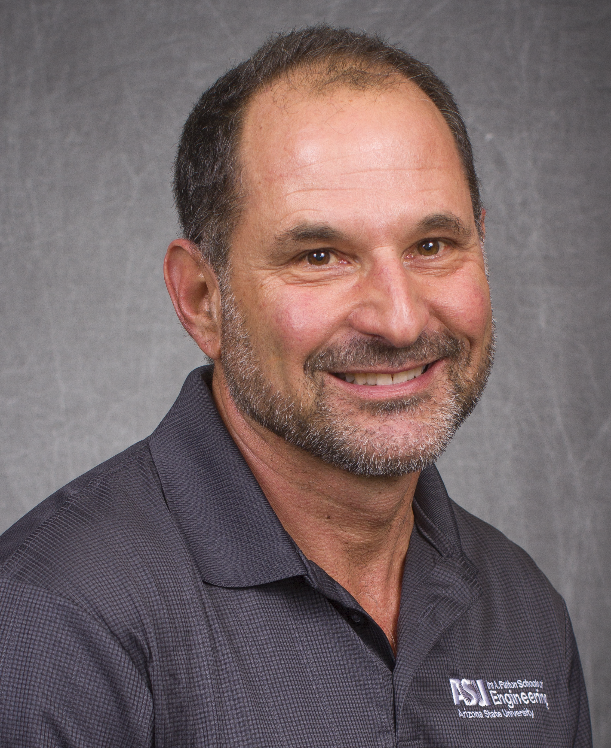
FSE promotes robust classroom assessment of Entrepreneurial Mindset. The 6 Best Practice strategies listed in this presentation promote effective EM assessment. The 4 examples reflect strategies that several FSE faculty are using to instill and reinforce EM. These assessment strategies are not difficult to implement. And, we are still learning. New approaches emerge as we continue working together. If you have an assessment that meets the 6 Best Practices, please let me know so others can benefit. If you have new ideas for EM assessment, please share! Thank you for your efforts, insights, and support of the EM initiative at Fulton Schools of Engineering.
The Kern Grant Leadership Team will continue offering support and resources to promote curiosity, make connections, and add value to your teaching and learning.
Gary Lichtenstein, Ed.D.
Director of EM@FSE Program Effectiveness
Ira A. Fulton Schools of Engineering
Email: gary.lichtenstein@asu.edu

