Slide 1
Character Discovery
EGR 111 – November 8, 2022
Dr. Adetoun Yeaman
Notes:
1 Min: Situate in overall agenda for the class session:
1. Introduction and open question (Melissa): Why does character matter to an engineer?
2. Activity: What kinds of character traits are most important for engineers? (We use sticky notes, compile a list and walk around the classroom)
3. Debrief of themes (why each team thought their themes were important)
4. Presentation (Adetoun):
Revisit allusions to character in EGR 111 and the vision of the whole engineer
What is character?
What are virtues?
Examples of what students might see in the curriculum
Summary of the relevance of character and character education in engineering
5. Explanation of Take-home Reflections (Melisaa):
A timeline of what your engineering trajectory could look like and where issues of character may come up/where different character traits might be relevant?
One trait
Exemplar
One virtue/character trait you would like to develop/further develop during your undergraduate career

Slide 2
The Wake Engineer vision
The WHOLE engineer
P.S.: This slide can be used to highlight aspects of the institutions vision, mission and/or initiatives that align with the concept f holistic engineering and character development

Slide 3
So far: various perspectives on engineering
History of engineering and Engineering Cultures
Engineering in the Renaissance
The history of engineering education
Silicon Valley and the ethics of investing
One-on-one with professors
Interview an engineer

Slide 4
What is Character?
Character is…
...the set of stable, deep, and enduring dispositions that define who we are and shape how we characteristically think, feel, and act.
Lamb et al., 2021; Annas, 2011; Aristole, 1999; Zagzebski, 1996

Slide 5
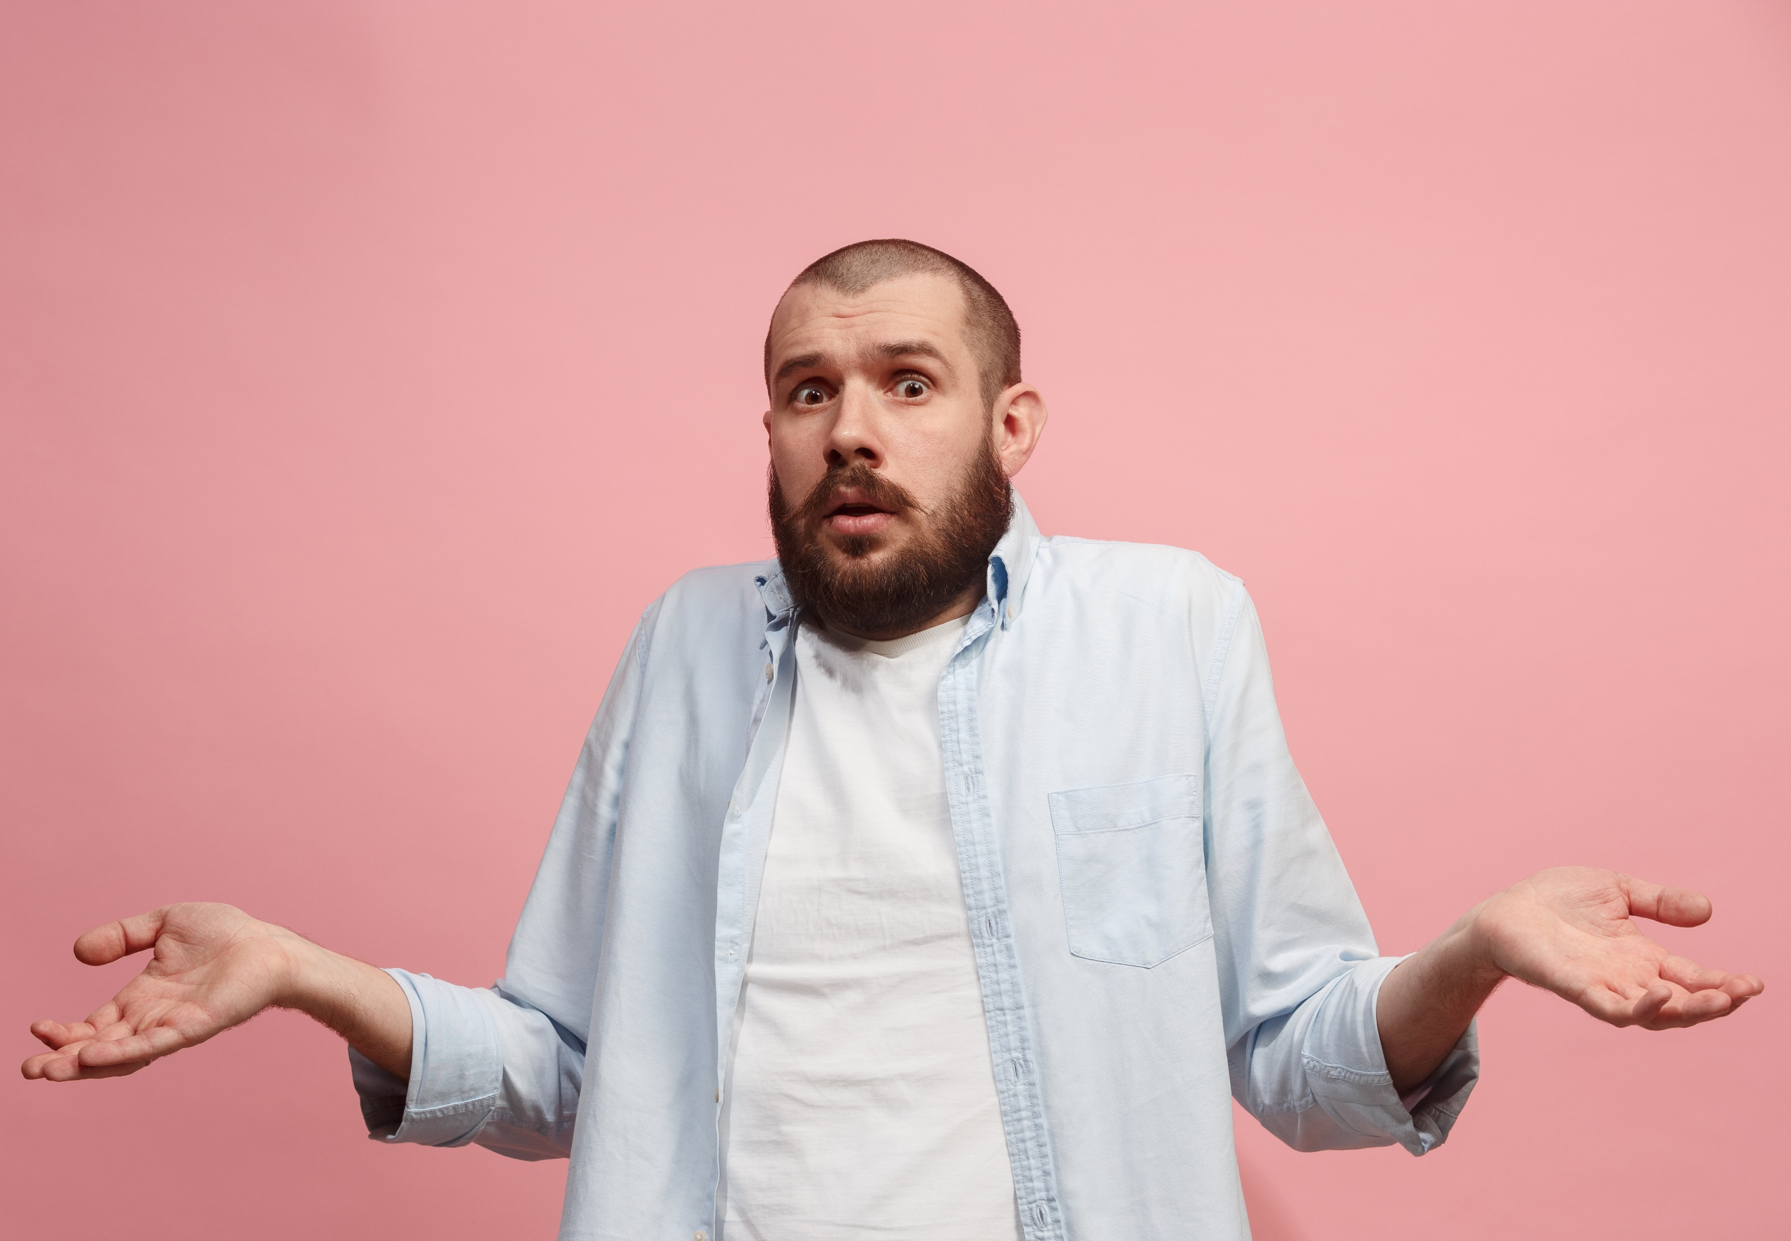
Why do we care about character in engineering?
Think about some takeaways from our activity earlier…
Think about some engineers you have interviewed…
Why does character matter in engineering?

Slide 6
Two kinds of moral character traits
Character
Virtues
Vices

Slide 7
Virtues…
…are habits that dispose us to think, feel, or act ‘at the right times, about the right things, toward the right people, for the right end, and in the right way.’
Also known as character strengths
This Photo by Unknown Author is licensed under CC BY-NC

Slide 8
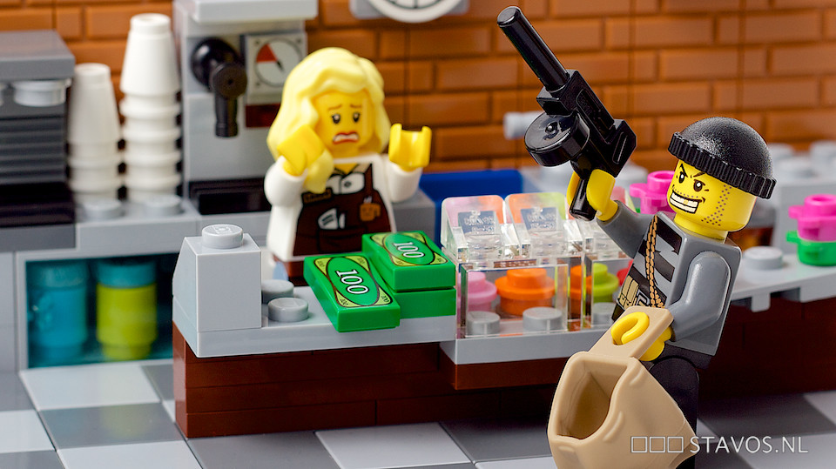
Vices…
…are habits that dispose us to think, feel, or act at the wrong times, about the wrong things, toward the wrong people, for the wrong end, or in the wrong way.
This Photo by Unknown Author is licensed under CC BY-NC-ND
Notes:
Some are less obvious

Slide 9
“The Golden Mean”
Virtues and Their Vices
Vice of Deficiency | Virtue | Vice of Excess
Cowardice Apathy Despair Self-Deprecation Insensitivity Stinginess Ingratitude Injustice Dishonesty | Courage Persistence Hope Humility Temperance Generosity Gratitude Justice Honesty | Rashness Stubbornness Presumption Pride/Arrogance Intemperance Wastefulness Ingratiation
Notes:
By practicing virtues, people are likely to make the right choice when faced with ethical challenges.
Character education offers us the language and tools to understand virtues in the context of practicing engineering
Character education supports deliberate practice of good character in engineering

Slide 10
Examples of Virtues
Virtues​
Intellectual​ | Moral​ | Performance​ | Civic​
Practical Wisdom​ Curiosity​ Creativity​ Intellectual Humility​ Critical Thinking​ | Empathy​ Courage​ Honesty​ Authenticity​ Justice​ Generosity​ Temperance​ Gratitude​ Hope​ | Resilience​ Teamwork​ Zest​ Diligence​ Leadership​ Followership​ | Service​ Citizenship​ Civility​
Jubilee Centre for Character and Virtues
Notes:
Emboldened ones are reflected in our curriculum

Slide 11
What are some active ways of developing good character?

Slide 12
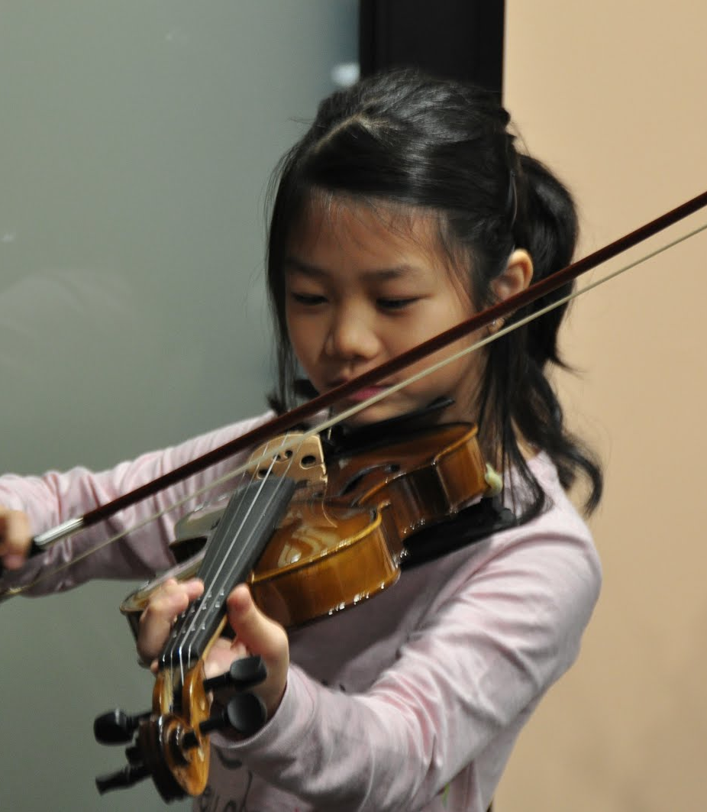
Habituation through practice
M. Lamb, J. Brant, & E. Brooks, “How Is Virtue Cultivated? Seven Strategies for Postgraduate Character Development,” Journal of Character Education 17, no. 1 (2021), 81–108.
This Photo by Unknown Author is licensed under CC BY-SA-NC

Slide 13
Reflection on personal experience
M. Lamb, J. Brant, & E. Brooks, “How Is Virtue Cultivated? Seven Strategies for Postgraduate Character Development,” Journal of Character Education 17, no. 1 (2021), 81–108.
This Photo by Unknown Author is licensed under CC BY-NC

Slide 14
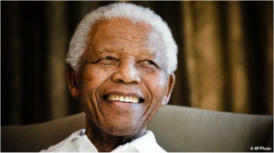
Engagement with virtuous exemplars
This Photo by Unknown Author is licensed under CC BY-SA-NC
M. Lamb, J. Brant, & E. Brooks, “How Is Virtue Cultivated? Seven Strategies for Postgraduate Character Development,” Journal of Character Education 17, no. 1 (2021), 81–108.

Slide 15
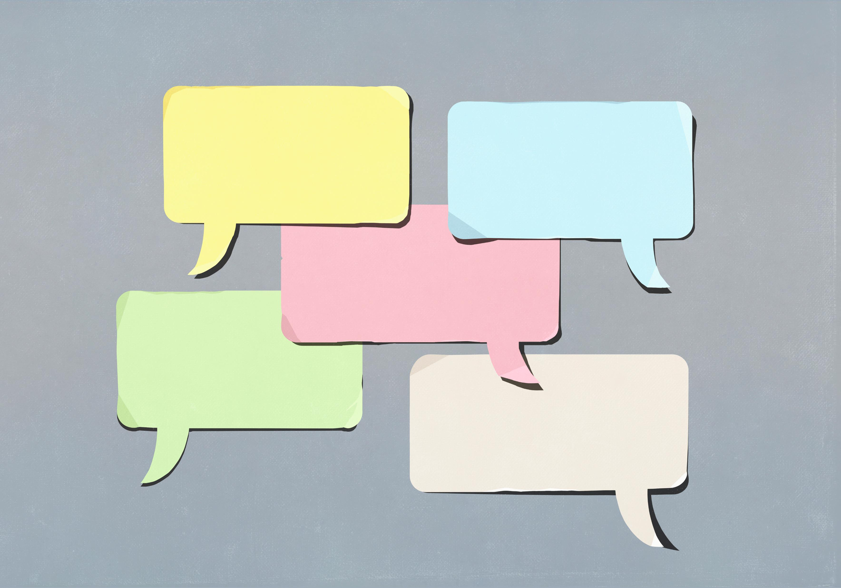
Dialogue to increase virtue literacy
M. Lamb, J. Brant, & E. Brooks, “How Is Virtue Cultivated? Seven Strategies for Postgraduate Character Development,” Journal of Character Education 17, no. 1 (2021), 81–108.

Slide 16
Awareness of situational variables and biases
M. Lamb, J. Brant, & E. Brooks, “How Is Virtue Cultivated? Seven Strategies for Postgraduate Character Development,” Journal of Character Education 17, no. 1 (2021), 81–108.

Slide 17
Moral reminders to make norms salient
M. Lamb, J. Brant, & E. Brooks, “How Is Virtue Cultivated? Seven Strategies for Postgraduate Character Development,” Journal of Character Education 17, no. 1 (2021), 81–108.

Slide 18
Friendships of mutual support and accountability
M. Lamb, J. Brant, & E. Brooks, “How Is Virtue Cultivated? Seven Strategies for Postgraduate Character Development,” Journal of Character Education 17, no. 1 (2021), 81–108.

Slide 19
In what ways do you want your own character to grow?

