Slide 1
Framing your research question with entrepreneurial mindset
Program Name
Date
Notes:
Watch intro video [5 min]

Slide 2
Why are you doing research?
Notes:
Facilitator:
“When you started research, was the project topic what you expected? Could you see how it matched with the broader goals of the lab or the goals you had for your research experience? Before we talk about specific research questions and topics, let’s talk about what motivated you to do research. Feel free to give any motivation, ranging from societal impacts to personal ones, such as career goals.”
Collect ideas from students (on white board for a small group, Poll Everywhere or jam board for larger groups). Briefly discuss common themes. Some of the motivations may be personal (career advancement), some of it is curiosity, but likely there is also interest among students in the impact of their research on societal and technical challenges.
“Do you ever feel like Emma in the video, where you are having trouble seeing how your original motivation connects with your current project? We’ll take some time today to talk about how you can link your research questions to opportunities with a potential for broader impacts.”
[5 min]

Slide 3
What are you researching?
Broad statement: Machine learning algorithms, batteries
Focused statement: Accurate prediction of the lifetime of lithium-ion batteries using machine learning techniques.
Specific claim / question: How does a lithium-ion battery lifetime predicted by a neural network-based machine learning model compare with a benchmark model that requires more computation time and a larger training set?
Notes:
Facilitator:
“When asked “What are you researching?”, we often have a one-liner for friends and family. This is our “broad statement”. As an example from the video, Emma’s one-line answer about what she is researching might be “machine learning algorithms”. That one-liner doesn’t give any information about the question we’re trying to answer or the problem we’re trying to solve though. Also, if you’re here because you’re working on an independent project or thesis, that short statement not going to be focused enough for a thesis topic. We need to narrow our topic to a focused statement where we can generate questions we want to answer.”
[Click to show focused statement] “Here’s an example of a focused statement for Emma’s project. The focused statement is still not a research question though – this is a topic you might see for an academic review paper you read as you are starting a project. From this focused statement, you can generate questions you want to answer.”
[Click to show specific question] “Here’s an example of one of many questions you could generate around the focused statement. If you’re in a large lab, your question might be assigned based on preliminary data the lab has already collected that indicates a promising area for research.”
Ask students to open the student slide deck and take about five minutes to fill out the first slide template with a broad statement, a focused statement, and one or two specific questions describing their research. Note that it is ok if they already have an assigned question in their lab – in that case, they may want to try to brainstorm a related question or work back to what they think the broad topic is to see the connection.
[7 minutes]

Slide 4
Opportunity
Research
Impact
Identify an opportunity
Determine requirements or research question
Communicate solution in economic terms
Investigate competitive solutions
Perform experiments
Communicate solution in terms of societal benefit
Create a preliminary business case
Analyze solutions
Validate market interest
Evaluate technical feasibility, societal benefits, economics
Develop new technologies
Develop partnerships and build a team
Test concepts via stakeholder engagement
Create a model or prototype
Identify implementation methods
Assess policy and regulatory issues
Validate functions
Protect intellectual property
Adapted from the KEEN Framework for Entrepreneurial Mindset
Notes:
Facilitator:
“Once you have a research question, you typically think about working through the research framework above (performing experiments, analyzing data, maybe creating a prototype). But in framing your research, it’s important to think not only about WHAT do I want to know but WHO is interested in the work and HOW can it have a broader impact.”
[Click to show opportunity / impact part of slide] “Entrepreneurial mindset gives one framework for connecting your research question to its eventual impact. First, there are some steps to define the opportunity associated with your research. What unmet need do you see? How are others addressing it? Is anyone else interested (business case or academic use)? How can you evaluate the feasibility? First, we’ll focus on the opportunity, unmet need, or open question you hope to address through your research and the possible competing ways of doing this. Knowing this can help you structure your research work in a way that delivers a unique and valuable solution that can have an impact on the larger problem.”
[3 minutes]

Slide 5
Needs
Related fields
Motivations
Stakeholder 2
Stakeholder 1
Stakeholder 3
Engineering theories
Reason A
Who is it important to?
Where to look for other solutions?
Previous work
Research question
Reason B
Why is it significant?
C
How is it addressed currently?
Reason C
B
What methods have been used to investigate?
X
Z
A
Y
Advantages
Motivations
Disadvantages
Notes:
Facilitator:
“It can be challenging to identify the “opportunity” or unmet need associated with your research. Consider that your research question may have practical significance, conceptual significance, or both.
Practical Significance – what cost will be borne by society or other stakeholder groups by not solving the problem?
Conceptual Significance – what is the larger thing that will remain unknown or unresolved without your work?”
“Identifying the opportunity associated with your research and possible competitive solutions will require some work on your part – whether it is talking to your advisor, doing a literature review, or connecting with stakeholders (as we’ll discuss in a minute). A great first step is to create a concept map to start to get your key questions down on paper. You don’t have to address them all at once, but it can give you a roadmap for something to work on in chunks throughout the summer or the semester.”
Take a couple minutes to highlight key questions on this example concept map. Also point at the more detailed example of a mind map for a literature review in the student resources handouts. Emphasize that you won’t answer all the questions on the mind map at once, but it starts to give a road map to branch out to more details. You could pick a single branch to work on each week over the summer. Give students about 7 minutes to start a concept map for their work in the student slides template.
[10 minutes]

Slide 6
Opportunity
Research
Impact
Identify an opportunity
Determine requirements or research question
Communicate solution in economic terms
Investigate competitive solutions
Perform experiments
Communicate solution in terms of societal benefit
Create a preliminary business case
Analyze solutions
Validate market interest
Evaluate technical feasibility, societal benefits, economics
Develop new technologies
Develop partnerships and build a team
Test concepts via stakeholder engagement
Create a model or prototype
Identify implementation methods
Assess policy and regulatory issues
Validate functions
Protect intellectual property
Adapted from the KEEN Framework for Entrepreneurial Mindset
Notes:
Facilitator:
“After identifying an opportunity and competitive solution, the framework of Entrepreneurial Mindset (EM) includes creating a business case. In research, creating a business case doesn’t mean you are planning to make a product and sell it right away. However, it does mean that you should think about who the stakeholders in your research are (those who will fund, use, review, or be impacted by your research), and why they would care about it. It may seem like this is only the concern of your lab’s principal investigator as they prepare grant applications to fund their work. However, as an individual contributor in the lab, understanding this context and identifying stakeholders can help you make informed decisions about your project direction and lead you toward the path of being able to independently propose new ideas. In the research context, forming the business case usually involves conducting a stakeholder analysis for your research and considering benefits to stakeholders associated with using your technologies. This is closely linked with evaluating broader societal and/or economic benefits.”
[2 minutes]

Slide 7
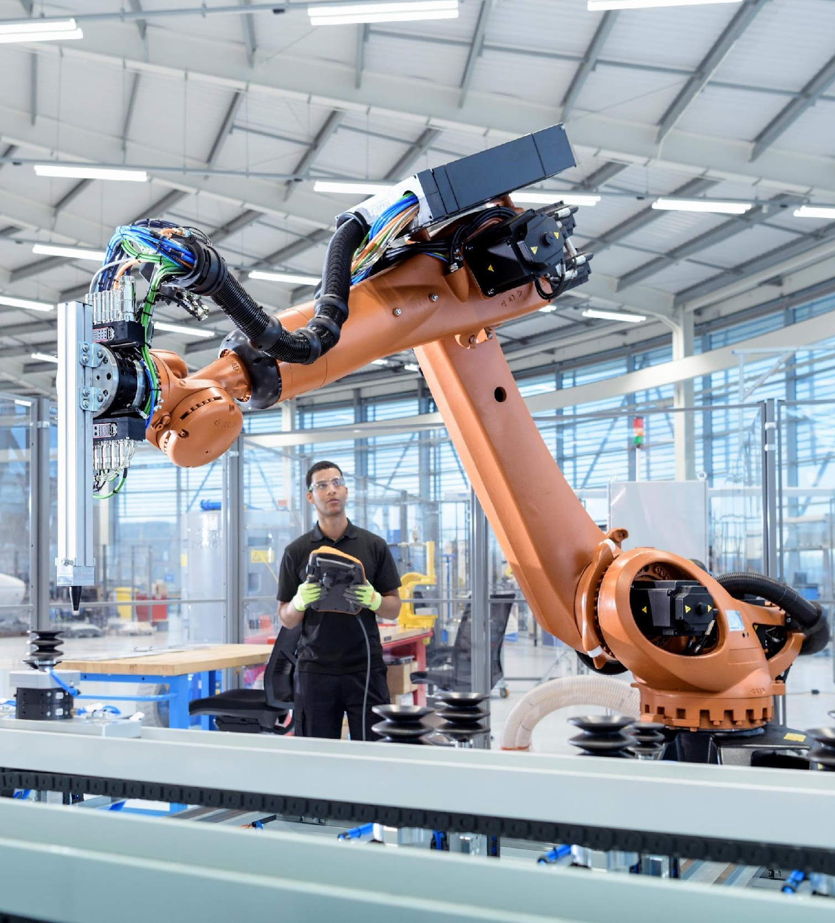
Connecting research with stakeholders
This Photo by Unknown Author is licensed under CC BY-SA-NC
Notes:
Facilitator:
“Let’s go through a brief example. Consider a researcher in a chemical engineering lab focused on development of new materials for photovoltaic (PV) cells. Stakeholders could include PV manufacturers (is the material easier to work with/ cheaper), electric utilities implementing PV solar systems (how would this impact their efficiency / cost), as well as policy makers (US policy on renewables will influence demand for these materials). The stakeholders can also be other academic labs who might build on this work or use a new technique you developed. Can you think of any others?”
“Prof. Mark Reed has created a variety of materials to help researchers maximize the impact of their work (see the links on the student handout). He suggests three key questions for stakeholder analysis in research.
Who is interested in my research? Could be interest from any direction, such as using the research directly or trying out a new technique you developed in the lab
How might they influence my ability to achieve impact (indirectly)? Influence could be funding your research, lobbying for its use, publicizing it, etc.
Who is impacted? There could be groups who are not currently interested in your research but could still be impacted by it (positively or negatively)”
Students have ~5 minutes to list possible stakeholders on the student slide template, along with the stakeholders’ interest in the research or its potential impact on them.
[8 minutes]

Slide 8
Opportunity
Research
Impact
Identify an opportunity
Determine requirements or research question
Communicate solution in economic terms
Investigate competitive solutions
Perform experiments
Communicate solution in terms of societal benefit
Create a preliminary business case
Analyze solutions
Validate market interest
Evaluate technical feasibility, societal benefits, economics
Develop new technologies
Develop partnerships and build a team
Test concepts via stakeholder engagement
Create a model or prototype
Identify implementation methods
Assess policy and regulatory issues
Validate functions
Protect intellectual property
Adapted from the KEEN Framework for Entrepreneurial Mindset
Notes:
Facilitator:
“As an undergraduate researcher, you are already doing a great job if you have thought about the first few aspects of identifying a research opportunity. However, that doesn’t mean you should only stop there! As you are doing your technical work, continue thinking about how you can engage with stakeholders and integrate their input into your project. This can be as simple as visiting another lab that might use your work and talking to graduate students there. For some work, it could even mean a visit to a field site where the project will be implemented. Along the way, you can also identify how existing policies and regulations might impact implementation of your work.”
Students take 2 minutes to brainstorm and jot down contacts, outside of their advisor, who could help them learn about stakeholder needs.
[3 minutes]

Slide 9
Approaches to connect research to societal impact
Research for impact
“Maximizing the opportunities for research processes to contribute to changes in policy, practice, and behavior”
Mark New: https://www.coursera.org/learn/research-for-impact
Transdisciplinary research
“Research that integrates knowledge across academic disciplines and with non-academic stakeholders to address societal challenges”
Utrecht University: https://www.uu.nl/en/research/transdisciplinary-field-guide/get-started/what-is-transdisciplinary-research
Notes:
Facilitator:
“If you are excited about this area, there are some additional conceptual frameworks you can explore focused specifically on stakeholder engagement. A key aspect of both research for impact and transdisciplinary research is early engagement with stakeholders to shape project direction. You can use links here and on your additional resources handout to find out more.”
[1 minute]

Slide 10
Traditional model
Transdisciplinary research
Applied Research
Applied Research
Curiosity-based Research
Curiosity-based Research
Collaboration
with stakeholders
Societal Demands
Societal Demands
Utrecht University: https://www.uu.nl/en/research/transdisciplinary-field-guide/get-started/what-is-transdisciplinary-research
Notes:
Facilitator:
“Even if your research falls closer to the category of basic science (curiosity-based research), there are still stakeholders and impacts to consider. Where does your research fall on this continuum? How can it drive development of new research areas?”
As time allows, the facilitator can include additional discussion.
[1 minute]

Slide 11
Opportunity
Research
Impact
Identify an opportunity
Determine requirements or research question
Communicate solution in economic terms
Investigate competitive solutions
Perform experiments
Communicate solution in terms of societal benefit
Create a preliminary business case
Analyze solutions
Validate market interest
Evaluate technical feasibility, societal benefits, economics
Develop new technologies
Develop partnerships and build a team
Test concepts via stakeholder engagement
Create a model or prototype
Identify implementation methods
Assess policy and regulatory issues
Validate functions
Protect intellectual property
Adapted from the KEEN Framework for Entrepreneurial Mindset
Notes:
Facilitator:
“Now that you’ve generated some ideas around the opportunity your research addresses and the possible stakeholders, let’s take some time to discuss. Your slides from this workshop are meant to be a living document that you can go back and edit as you learn more about your project. Keep reviewing your research direction and how it links to the impacts you ultimately want to achieve.”
Students then get into groups of 3-4 to discuss what they have generated so far in their portfolio slides, and concerns that they have in developing an understanding of their research opportunity.
Suggested structure for discussion time (~10 minutes):
Introductions (name, department, what lab you’re working in, broad overview of your project)
Take turns sharing key points from your concept map: What is the research question at the center of the concept map and why is it significant?
Can you see any connections between the topics of each group member? Could there be some similar stakeholders or impacts to think about? There may not be any clear connections and that is ok too.
Choose the research question of one group member as an example and discuss impact/stakeholders. Can group members think of any new stakeholders, beyond those identified in the initial brainstorming session? Continue with other research questions as time allows.
During the remaining time in the workshop, the facilitator can invite 1-2 student groups to report out on any concerns they had or questions where it was particularly difficult to identify significance or stakeholders. The facilitator and larger group can provide some feedback or ideas to address the concerns.
[15 minutes]

Slide 12
Discussion topics
Introductions (name, department, what lab you’re working in, broad overview of your project)
Take turns sharing key points from your concept map: What is the research question at the center of the concept map and why is it significant?
Can you see any connections between the topics of each group member? Could there be some similar stakeholders or impacts to think about? There may not be any clear connections, and that is ok, too.
Choose the research question of one group member as an example and discuss impact / stakeholders. Can group members think of any new stakeholders, beyond those identified in the initial brainstorming session? Continue with other research questions as time allows.
Notes:
The facilitator can show this slide during discussion time to remind groups of discussion topics.

