Slide 1
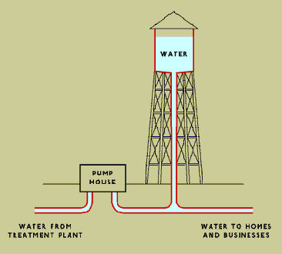
Water Towers
What is their purpose?
Storage and distribution of potable water
Utilized in the event of a power outage
Allows towns to pump for the average consumption than the maximum
How do they work?
Water is sourced from water treatment plants and pumping stations.
The tower’s height is determined by the elevation and pressure needed.
Water is constantly being moved in and out to regulate its temperature.

Slide 2
Websites Cited:
http://people.howstuffworks.com/water.htm
https://www.livescience.com/54236-how-do-water-towers-work.html
http://mentalfloss.com/article/64577/how-do-water-towers-work
http://www.oak-forest.org/196/The-Water-System
Accessed 8/24/17

