Slide 1
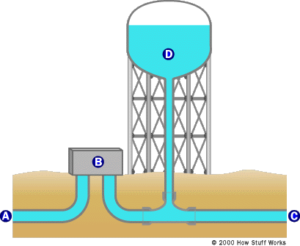
Water Towers
Why do we need them?
How do they work?
Serves as a supply system for the distribution of potable water
Serves as a backup water supply in case main water system is damaged
Provides emergency storage for fire protection
Stores the water during non-peak hours to use during peak hours
Excess flow is stored
Need-based
Reliable - water supply is constant since water flow is pressurized by gravity
Notes:
A) The water is treated in a water treatment plant to remove sediment (by filtration and/or settling) and bacteria (typically with ozone, ultraviolet light and chlorine). The output from the water treatment plant is clear, germ-free water.
B) A high-lift pump pressurizes the water and sends it to the water system's primary feeder pipes.
C) Water that is pumped into our sinks,etc.
D) A water tower's tank is normally quite large (generally 50x an average swimming pool). Water towers are tall and located on high ground to provide pressure and use gravity to move the water.

