Slide 1
How Analogies Fit in a Framework for Supporting the Entrepreneurial Mindset in an Electric Circuits Course
2019 ASEE Conference
June 16, 2019
Heath J. LeBlanc
Electrical & Computer Engineering and Computer Science (ECCS) Department
Ohio Northern University
Ada, OH, USA
Khalid Al-Olimat
Electrical & Computer Engineering and Computer Science (ECCS) Department
Ohio Northern University
Ada, OH, USA
M. Ajmal Khan
Electrical & Computer Engineering and Computer Science (ECCS) Department
Ohio Northern University
Ada, OH, USA
Firas Hassan
Electrical & Computer Engineering and Computer Science (ECCS) Department
Ohio Northern University
Ada, OH, USA
Acknowledgment: This was created through work with the Kern Entrepreneurial Engineering Network.
More content can be found at EngineeringUnleashed.com.

Slide 2
KEEN’s 3Cs Definition of Entrepreneurial Mindset (EM)
Constant curiosity about our changing world
Curiosity
Integrating information from many sources to gain insight
Connections
Identifying unexpected opportunities to create value
Creating value
“An entrepreneurial mindset is an entire outlook on life.”
Notes:
EM is not entrepreneurship; it’s a set of attitudes and dispositions that are precursors to entrepreneurial action

Slide 3
Supporting the EM in the Circuits course
Curiosity
Question Formulation
Targeted exploration (research on question of interest)
Connections
Analogies
Creating Value
Need finding/opportunity recognition
Design-build-test
Value Proposition for design solution
Notes:
Discuss how each target approach is tied to the EM.

Slide 4
Circuits Course Activities & Assignments
In-Class Group Problems
Quizzes
Two Midterm Exams & Final Exam
Laboratory Experiments & Lab Final
Question Submissions: 3 sets each with $≥$3 questions
Circuit Research Question Exploration
Circuit Analogy Reflection
Circuit Design Project
Notes:
Give a brief description of each

Slide 5
Supporting the EM in the Circuits course
Curiosity
Question Formulation
Targeted Exploration (research on question of interest)
Learning Objectives:
Develop a propensity to ask more questions.
Formulate salient questions related to electric circuit analysis and design.
Recognize and explore circuit knowledge gaps.
Identify and evaluate sources of information.
Notes:
Discuss learning objectives related to curiosity

Slide 6
Exploration Question Single-Point Rubric
 |  |  | Rating |  |  |  | Comments Provide comments for each evaluation section, especially for performance marked above or below expectations
 |  | Above | Meets Expectations |  | Below | Score
Question | Structure | ☐ | ☐ | Grammar: Correct spelling, punctuation and grammar | ☐
 |  | ☐ | ☐ | Clarity: Language structure and wording clearly convey the idea(s) under investigation | ☐
 | Propensity for Exploration | ☐ | ☐ | Topic Relevance: Relevant to correct topic coverage within the course. | ☐
 |  | ☐ | ☐ | Topic Orientation: Directs the attention of the audience in one or more clear topic directions or conceptual paths to explore | ☐
 |  | ☐ | ☐ | Potential for Deep Exploration: Uncovers additional layers of the topic, deeply examines or analyzes the topic, or inquires about a relation or connection between or among topics | ☐
Template based on Single Point Student-Client Interaction Rubric Version 5.0 by John K. Estell & Susannah Howe
Notes:
Discuss the single-point rubric for evaluating questions for targeted exploration; use vector analogy to explain topic orientation (direction) and potential for deep exploration (magnitude).

Slide 7
Question of the day (good example)
What are the applications of RL and RC circuits within the manufacturing sector or other industries?
Grammar (9/10)
Clarity (9/10)
Relevance (10/10)
Topic Orientation (9/10)
Depth of Exploration (10/10)
Total (47/50) – 94%
Notes:
Discuss elements of question that led to scores

Slide 8
Question of the day (bad example)
Why are complex numbers so complex?
Grammar (10/10)
Clarity (8/10)
Relevance (8/10)
Topic Orientation (5/10)
Depth of Exploration (3/10)
Total (34/50) – 68%

Slide 9
Question Exploration Report
Short technical report (1-2 pages)
Use librarians and/or Writing Center! (+5%)
Grading (see handout for format, etc.)
Format & writing quality (paragraph structure, grammar, etc.) – 10 pts
Exploratory question – 20 pts (Topic orientation/potential for depth)
Exploration summary – 40 pts
Demonstration of basic understanding of topic – 20 pts
References provided where appropriate – 10 pts
Additional questions to demonstrate you know what you don’t know – 10 pts
Evaluation of technical resource (peer-reviewed or edited) – 20 pts
References list in bibliography – 10 pts (IEEE reference style)
Proposed Question Due: Tuesday, October 23
Due: Tuesday, November 13

Slide 10
Supporting the EM in the Circuits course
Creating Value
Need finding/opportunity recognition
Design-build-test
Value Proposition for design solution
Learning Objectives:
Explores multiple solution paths in the circuit design process.
Identifies a market, market opportunities, or customer needs.
Modifies a design based on instructor feedback.
Gathers experimental and simulation data to support or refute circuit design ideas.
Craft a compelling value proposition tailored to specific stakeholders.
Notes:
Discuss learning objectives for creating value

Slide 11
Design Project Overview
Organize into inter-department groups of 3 to 5
Design and build a temperature sensing circuit
Startup company bidding for seed funding
Determine an important need
temperature range (25˚C - 50˚C)
Pitch a proposal (in writing)
Build prototype for testing
Use breadboard
Develop Test Plans and Implement in lab
Value Proposition

Slide 12
Process for Creating Value Propositions: NABC Process
Developed by SRI International
N = Need
What is the important stakeholder Need?
A = Approach
What is the unique Approach for addressing this need?
B = Benefits per Costs
What specific Benefits per costs result from the approach?
C = Competition
How are the benefits per costs superior to the Competition’s and the alternatives?
Notes:
Communicating the value of an idea…
What is the important Need addressed?
Who is the audience (stakeholders)?
Are there relevant stakeholder pain points? Opportunities?
What is the Approach to address the need? The approach can be technical or business related.
What stakeholders Benefit from the idea? How?
What are the associated costs to the stakeholder?
What is the Competition?

Slide 13
Supporting the EM in the Circuits course
Connections
Analogies
Learning Objective:
Connect life experiences with electric circuit content.
Notes:
Discuss learning objective for analogies

Slide 14
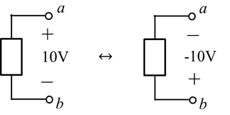
Analogy: Voltage is like altitude
Hill analogy (polarity)
Notes:
Build’s on Keppler’s analogy between gravitational and electric fields. Discuss going uphill/downhill in a circuit.

Slide 15
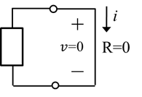
Analogy: Wires are flat!
Notes:
Ideal conductors have no potential drop.

Slide 16
Analogy: Circuit ground is like sea-level
Notes:
Analogy: Ground is like sea level. Building on the altitude analogy for voltage, altitude at each point on Earth is defined with respect to sea level. Similarly, each node voltage in a circuit is defined with respect to the ground node. The altitude of land at sea level is 0 m. The voltage of the ground node is 0 V.
Introduced with nodal analysis. Ocean floor is below sea level just like nodes can be below ground potential.

Slide 17
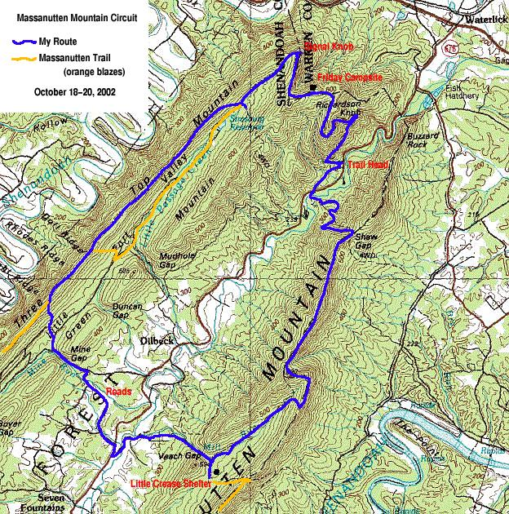
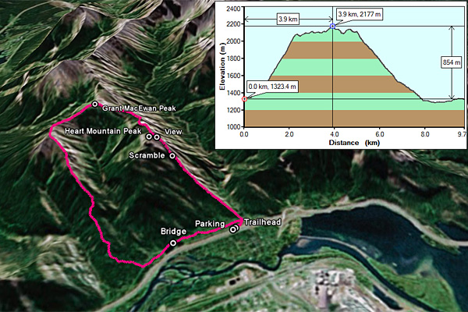
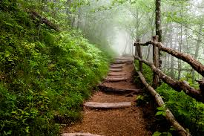
Analogy: A KVL hike up a mountain

Slide 18
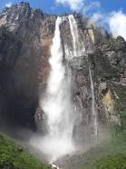
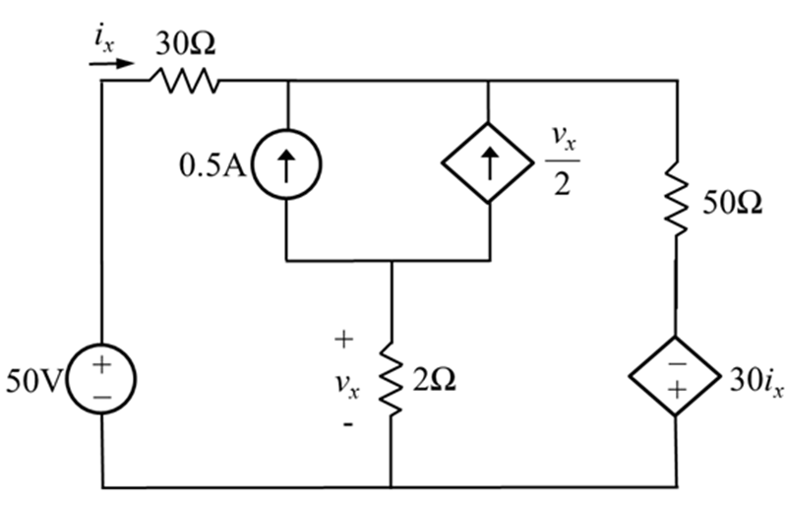
Analogy: Current source is like a waterfall
On KVL hikes,
AVOID HIKING WATERALLS!
Find an alternative path up or down the waterfall!
Supermesh!
Notes:
Emphasize limitation of this analogy.

Slide 19
Analogy: Parallel resistors work in parallel on the job
Mary takes 2 hours to paint a room
John takes 4 hours to paint it
How long will it take if they work in parallel?
Use product-over-the-sum rule
Use time per job in the calculation
$Parallel Work Time$ $=\frac{\left(2\right)\left(4\right)}{2+4}=\frac{8}{6}=1.33 hours$
Notes:
Analogy: Parallel resistors work in parallel on the job. Combining parallel resistors is like combining people working in parallel on a job. For example, suppose Mary takes 2 hours to paint a room and John takes 4 hours to paint it. How long would it take if they paint working in parallel? Clearly, it should take less than 2 hours, which is the least amount of time among the people working alone. It turns out that the product-over-the-sum rule works since there are exactly 2 people working in parallel. Hence, it takes $\frac{\left(2\right)\left(4\right)}{2+4}=\frac{8}{6}$or 1.33 hours to complete the job (i.e., paint the room). Note that we should use the amount of time to complete the job in the calculations.
Point out that it’s less than the amount of time Mary would take alone.

Slide 20
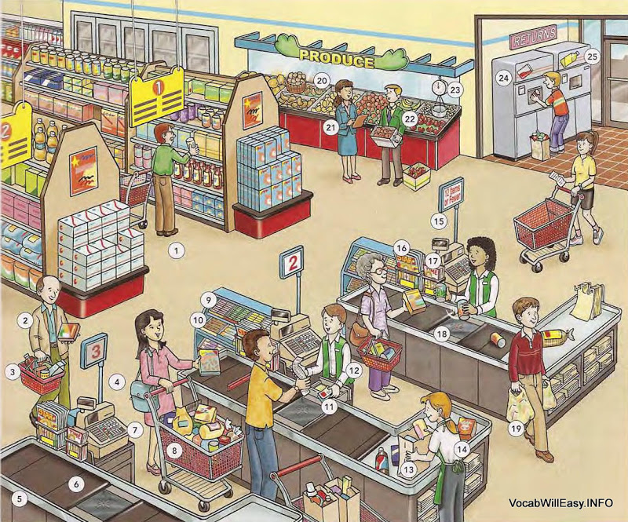
Analogy: Conductance is like work rate
Used time per job in the parallel resistance analogy
Reciprocal of time per job is work rate
Reciprocal of resistance is conductance
Mary (15 customers per hour)
John (10 customers per hour)
$Parallel Work Rate$ $=15+10$
$$=25 customers/hour$$
Notes:
Analogy: Conductance is like work rate. From the parallel resistor analogy we see that the time required to complete a job for people working in parallel is calculated in the same way as parallel resistance when the resistance is matched to the amount of time each person requires to complete the job. The reciprocal of time per job is work rate (i.e., amount of a job done per unit time); hence we can relate conductance to work rate. For example, suppose Mary and John are cashiers at a grocery store and Mary can check out 15 customers per hour while John can check out 10 customers per hour (their work rates). Clearly, working in parallel, Mary and John can check out 15 + 10 = 25 customers per hour.

Slide 21
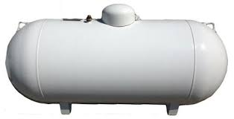
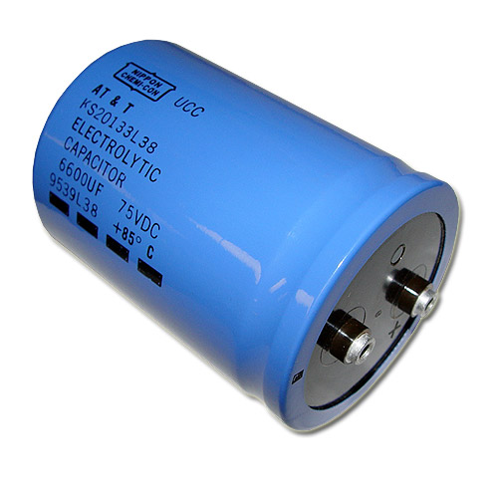
Analogy: Caps are like pressurized tanks!
Notes:
Consider a tank holding a compressible gas, such as a pressurized CO₂ tank. The geometry of the tank will determine how much compressed gas it can hold, as well as the material properties of the tank. Think of the material properties of the tank walls as similar to the permittivity of the dielectric. Changing the dielectric in the design of the capacitor would be like changing the material of the tank walls. The pressure in the tank is like the voltage across the capacitor. We may increase the pressure to increase the amount of gas that can be held in the tank, but there will be a critical pressure beyond which the tank will rupture (or explode). Similarly, there is a critical voltage, called the breakdown voltage of the capacitor, beyond which the capacitor will be damaged (or explode). Be careful never to exceed the breakdown voltage of the capacitor. Again, from the pressurized tank analogy, we can see how a charged capacitor can be dangerous.

Slide 22
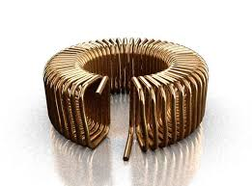
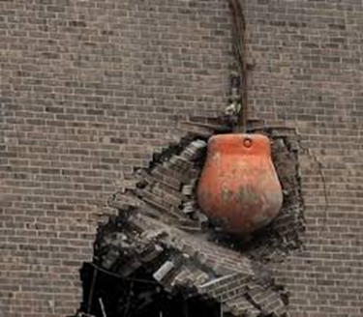
Analogy: Inductors are wrecking balls!
$$W_{L}=\frac{1}{2}LI^{2}$$
$$W_{M}=\frac{1}{2}Mu^{2}$$
Notes:
Builds on traditional mechanical analogue, but used to emphasize inductive kickback.

Slide 23
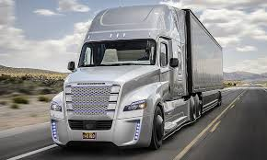
Analogy: RL energy dissipation is like a big rig stopping!
Mass = inductance
Friction = resistance
$τ=\frac{L}{R_{TH}}$
Notes:
Energized inductors are like masses in motion. Resistors model energy dissipation similar to friction in mechanical systems. Imagine a large big rig (eighteen-wheeler) traveling at moderate velocity and then trying to stop quickly. The larger the big rig (mass), the longer it will take to stop (larger $τ$). Also, the weaker the brakes, or if there are poor road conditions (less friction in either case), then also the longer it will take to stop (larger $τ$). An energized RL circuit is similar. The larger the inductance (like mass), the longer it will take to de-energize the inductor. Similarly, the smaller the equivalent resistance seen by the inductor (like the friction), the longer it will take to de-energize. Hence the time constant of the RL circuit is directly proportional to inductance $L$ and inversely proportional to resistance $R_{TH}$.

Slide 24
Circuit Analogy Reflection Assignment
Many analogies given throughout term
Consider one of these or propose your own!
Identify deep structure between topics in the analogy
Connect the analogy to life experience
Grading (see handout for format, etc.)
Typesetting, format, and writing quality (paragraph structure, grammar, etc.) – 10 points
Analogy statement – 10 points (either your own or transcribed from the notes)
Analogy deep structure description – 20 points
Connection to life experience – 10 points
Due: Tuesday, November 6

Slide 25
Summary/Future Work
Great student feedback on analogies
No negative feedback analogies or assignments
Assessment
Question Formulation
Letter grade improvement
Analogy Reflection
High B average
Students need to improve value props
HW assignments to be introduced
Program-wide assessment of EM learning outcomes

Slide 26
Questions?

Slide 27
References
[1] E. M. Eisenstein, “Engineering and entrepreneurship: Creating lasting value from engineering,” in IEEE Transforming Engineering Education: Creating Interdisciplinary Skills for Complex Global Environments, Dublin, 2010, pp. 1-15.
[2] “KEEN - Home,” KEEN - Engineering Unleashed. [Online]. Available: https://engineeringunleashed.com/. [Accessed: 30-Jan-2019].
[3] D. Rae and D. E. Melton, “Developing an entrepreneurial mindset in US engineering education: an international view of the KEEN project,” The Journal of Engineering Entrepreneurship, 7(3), 2017.
[4] T. G. Reio Jr, and A. Wiswell, “Field investigation of the relationship among adult curiosity, workplace learning, and job performance,” Human Resource Development Quarterly, 11(1), pp. 5-30, 2000.
[5] T. J. Kriewall and K. Makemson, “Instilling the entrepreneurial mindset into engineering undergraduates,” The Journal of Engineering Entrepreneurship, 1(1), pp. 5-19, July 2010.
[6] J. Wheadon and N. Duval-Couetil, “Elements of entrepreneurially minded learning: KEEN white paper,” The Journal of Engineering Entrepreneurship, 7(3), pp. 17-25, 2016.

Slide 28
References
[7] A. Gerhart and D. E. Melton, “Entrepreneurially minded learning: Incorporating stakeholders, discovery, opportunity identification, and value creation into problem-based learning modules with examples and assessment specific to fluid mechanics,” The Journal of Engineering Entrepreneurship, 8(1), pp. 44-62, 2017.
[8] T. J. van Schijndel, B. Jansen, and M. Raijmakers. “Do individual differences in children’s curiosity relate to their inquiry-based learning?,” International Journal of Science Education, 40(9), pp. 996-1015, 2018.
[9] R. Duit, “On the role of analogies and metaphors in learning sciences,” Science Education, 75(6), pp. 649-672, 1991.
[10] D. E. Brown, “Refocusing core intuitions: A concretizing role for analogy in conceptual change,” Journal of Research in Scientific Teaching, 30(10), pp. 1273-1290, 1993.
[11] B. Leavy, “Collaborative innovation as the new imperative – design thinking, value co-creation and the power of “pull”,” Strategy & Leadership, 40(2), pp. 25-34, 2012.
[12] C. L. Dym, A. M. Agogino, O. Eris, D. D. Frey, and L. J. Leifer, “Engineering design thinking, teaching, and learning,” Journal of Engineering Education, 94(1), pp. 103-120, 2005.

Slide 29
References
[13] M. J. de Almeida, A. Salvador, and M. M. Costa, “Analogy for Drude’s free electron model to promote students’ understanding of electric circuits in lower secondary school," Physical Review Special Topics-Physics Education Research, 10(2), 020118, 2014.
[14] D. Black and J. Solomon, “Can pupils use taught analogies for electric current?,” School Science Review, 69, pp. 249-254, 1987.
[15] S. M. Glynn and T. Takahashi, "Learning from analogy‐enhanced science text," Journal of Research in Science Teaching, 35(10), pp. 1129-1149, 1998.
[16] D. R. Gentner and D. Gentner, “Flowing waters or teeming crowds: Mental models of electricity,” Mental models, pp. 99-129, 1983.
[17] S. M. Glynn, “Explaining science concepts: A teaching-with-analogies model,” The Psychology of Learning Science, pp. 219-240, 1991.
[18] R. J. Spiro, P. J. Feltovich, R. L. Coulson, and D. K. Anderson, “Multiple analogies for complex concepts: Antidotes for analogy-induced misconception in advanced knowledge acquisition,” In S. Vosniadou & A. Ortony (Eds.), Similarity and analogical reasoning. Cambridge: Cambridge University Press, pp. 498-531, 1989.

Slide 30
References
[19] D. L. Schwartz, J. M. Tsang, and K. P. Blair. The ABCs of How We Learn: 26 Scientifically Proven Approaches, How They Work, and When to Use Them. W. W. Norton & Company, Inc., New York, NY, 2016.
[20] D. Gentner, S. Brem, R. W. Ferguson, A. B. Markman, B. B. Levidow, P. Wolff, and K. D. Forbus, “Analogical reasoning and conceptual change," Journal of the Learning Sciences, 6(1), pp. 3-40, 1997.
[21] J. K. Estell and S. Howe, “Development and use of a client interaction rubric for formative assessment,” In Proceedings of the 2017 ASEE Annual Conference & Exposition, Columbus, OH, June 2017.
[22] F. Hassan, H. LeBlanc, and K. Al-Olimat, "Inculcating an entrepreneurial mindset in engineering education: Project approach," In IEEE Frontiers in Education Conference, pp. 121-126, 2013.
[23] C. Kearny, T. Newby, and D. Stepich, “Building bridges: Creating instructional analogies,” presentation at the Annual Convention of the National Society for Performance and Instruction, Atlanta, GA, March 1995.
[24] S. Kamalasadan, K. S. Al-Olimat, Fuzzy Logic Control Systems, Invited Book Chapter, Encyclopedia of Computer science and Engineering, edited by Benjamin Wah. John Wiley & Sons, Hoboken, NJ, ISBN: 978-0-471-38393-2, Vol 2, pp. 1344-1355, March 2009.

Slide 31
Extra Slides

Slide 32
Student Comments
Very well structured and thought out. Though there was a load of material to cover it was all conveyed in a reasonable and effective manner. Analogies also helped in understanding all the material well.
[T]he analogies and homework were the best teaching methods.
[The instructor] did a good job of relating information to students in real world examples and analogies that we can understand and comprehend.
The analogies were very good at helping relate the concepts to prior knowledge.
It was very helpful to have complex ideas explained with analogies.
I really liked that [the instructor] would give us analogies to help us understand harder topics with topics we already understood.

Slide 33
Syllabus: Grading
Homework: 10%
Quizzes: 10%
Laboratory Experiments & Lab Final: 10%
Design Project: 5%
EML Assignments: 5%
Midterm Exams (15% each): 30%
Final Exam: 30%
All exams are closed book and notes.
A: 90-100, B: 80-89, C: 70-79, D: 60-69 & below 60 is F.

Slide 34
Electric Circuits course mind map
Electric Circuits
[Course]
requires the understanding of
Circuit Analysis Fundamentals
[Module 1]
are used to describe the two temporal
modes of circuit behavior
Steady State Response
Transient Response
describes the long term
behavior of a circuit & is
applicable to
describes the short term
behavior of a circuit &
is critical to consider
when the circuit is
DC Circuits
[Module 2]
AC Circuits
[Module 5]
1st Order
[Module 4]
is used to design circuits to perform signal manipulation
using
are implemented
in practice for the electric grid & industrial applications as
Higher Order
Op Amps
[Module 3]
Polyphase Circuits
[Module 6]

Slide 35
Course Schedule
Wk | Wk Begin | Monday | Wednesday | Friday | Lab
1 | 08/20 | 1.1-1.4 | 1.4-1.5 | 2.5-2.7
 |  |  | HW 1 1.3, 1.14, 1.19 | HW 2 2.13, 2.14, 2.18
2 | 08/27 | 3.1-3.3 | 4.1-4.4 | 5.1-5.3 | Lab 1: Ohm’s Law & Power Rating
 |  | HW 3 3.4, 3.14, 3.18 | HW 4 4.6, 4.11, 4.15, 4.17 | HW 5 5.2, 5.5, 5.6, 5.13
3 | 09/03 | Labor day | 6.1-6.2 | 6.2-7.1 | Lab 2: KVL & Voltage Dividers Questions 1 Due
 |  | No Class | HW 6 6.2, 6.3, 6.19 | HW 7 6.7, 6.20, 7.1
4 | 09/10 | 7.1-7.2 | 8.1-8.2 | 8.3 | Lab 3: Node & Mesh Analysis
 |  | HW 8 7.3, 7.10, 7.17 | HW 9 8.2, 8.3, 8.4 | HW 10 8.5, 8.8, 8.9
5 | 09/17 | 8.3-8.4 | 8.5 | 9.1-9.3 | Lab 4: Superposition Theorem
 |  | HW 11 8.6, 8.7, 8.14 | HW 12 8.17, 8.19, 8.20 | HW 13 9.2, 9.6, 9.9

Slide 36
Course Schedule
Wk | Wk Beg | Monday | Wednesday | Friday | Lab
6 | 09/24 | Material Reinforcement | Exam 1 | 9.3 | Lab 5: Thevenin & Max Power Questions 2 Due
 |  |  | Chapters 1-8 | HW 14 9.11, 9.19, 9.20
7 | 10/01 | 10.1-10.2 | 10.3 | 11.1-11.2 | Lab 6: Op Amp Circuits Project Assigned
 |  | HW 15 10.2, 10.7, 10.8 | HW 16 10.14, 10.15, 10.17 | HW 17 11.3, 11.4, 11.5
8 | 10/08 | Fall Break | 11.3 | RC & RL examples | Lab 7: Circuit Design (Take Home)
 |  | No Class | HW 18 11.12, 11.13, 11.14 | HW 19 11.11, 11.16
9 | 10/15 | 12.1-12.4 | 12.4.1-12.5 | 12.6-12.8 | Lab 8: 1st Order Circuit Exploration Due
 |  | HW 20 12.1, 12.2, 12.3, 12.5 | HW 21 12.6, 12.7, 12.8 | HW 22 12.10, 12.11, 12.13

Slide 37
Course Schedule
Wk | Wk Beg | Monday | Wednesday | Friday | Lab
10 | 10/22 | 12.9-12.11 | Material Reinforcement | Exam 2 | Lab 9: AC RC Circuit Questions 3 Due
 |  | HW 23 12.15, 12.19, 12.20 |  | Chapters 9-12
11 | 10/29 | 13.1-13.4 | 13.5 | 14.1-14.3 | Lab 11: RLC Circuit Design Alts Due
 |  | HW 24 13.4, 13.10, 13.11 | HW 25 13.14, 13.15, 13.17 | HW 26 14.1, 14.2, 14.4
12 | 11/05 | 14.3-14.5 | 14.6 | 14.7-14.9 | Lab 10: AC Circuit Analysis Analogy Reflection
 |  | HW 27 14.6, 14.8, 14.9, 14.11 | HW 28 14.13, 14.15 | HW 29 14.17, 14.18, 14.20
13 | 11/12 | 14.9-14.11 | 15.1-15.3 | 15.4 | Design Project Implemen-tation
 |  | HW 30 14.21, 14.24, 14.27 | HW 31 15.1, 15.2, 15.3 | HW 32 15.4, 15.5

Slide 38
Course Schedule
Wk | Wk Beg | Monday | Wednesday | Friday | Lab
14 | 11/20 | Thanksgiving | Thanksgiving | Thanksgiving | Lab 12: Take-Home
 |  | No Class | No Class | No Class
15 | 11/26 | 15.4 | 15.4 | 15.5 | Lab 13: PF Correction Final Proposals Due
 |  | HW 33 15.8, 15.9 | HW 34 15.10, 15.11, 15-15 | HW 35 15.17, 15.18, 15.19
16 | 12/03 | 16.1-16.6 | 16.6-16.7 | Review | Lab 14: 3 Phase Circuits Project Demos Lab Final
 |  | HW 36 16.3, 16.5, 16.6 | HW 37 16.10, 16.11, 16.14

Slide 39
Analogies: A Tool for Creating Connections
Analogical reasoning questions
Deluge is to Droplet as:
Beach is to Wave
Desert is to Oasis
Blizzard is to Icicle
Landslide is to Pebble
Cloudburst is to Puddle
Schwartz, Tsang, and Blair, “The ABCs of How We Learn,” W.W. Norton & Company, New York, 2016.
Notes:
Mention SAT exam and other standardized tests. Allow participants to discuss for a minute what the commonalities are between the sample relationship and the options.

Slide 40
Analogies: A Tool for Creating Connections
Analogical reasoning questions
Deluge is to Droplet as:
Beach is to Wave
Desert is to Oasis
Blizzard is to Icicle
Landslide is to Pebble
Cloudburst is to Puddle
Same surface features
(both water)
Same deep structure
(both catastrophic events caused by an overabundance of benign components)
Same surface features
(both water)
Schwartz, Tsang, and Blair, “The ABCs of How We Learn,” W.W. Norton & Company, New York, 2016.
Notes:
(a) and (e) have the same surface features in that they all involve water. The first words of (c) the statement are related as catastrophic events and the second words of (b) and the statement are related as comprised of water. Only (d) has the same deep structure between the relationships – catastrophic events caused by an overabundance of small, benign parts.

Slide 41
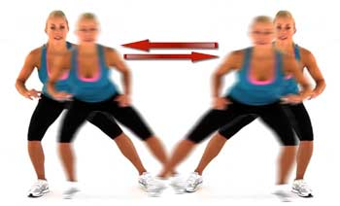
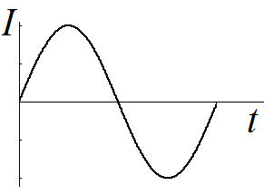
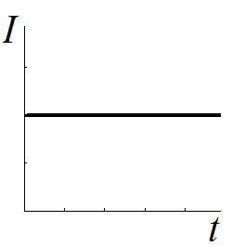
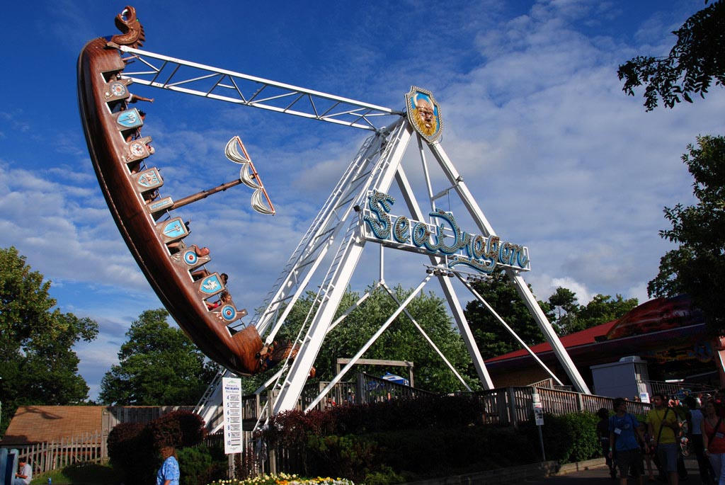
AC vs. DC current
Shuffle exercise
Jogging
Notes:
Analogy: DC and AC Exercises. DC current is like the steady pace of a group of marathon runners. Although technically the charges do not all move with constant velocity in a DC current, the net effect is a steady, constant charge flow. AC current is like an exercise class doing the side shuffle exercise in synchrony. Individual charges do not move with perfect sinusoidal motion; however, the net effect of the motion of charges is a sinusoidal rate of charge flow with time.

Slide 42
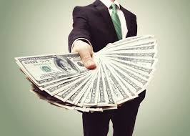
Power is the time rate at which energy is supplied or absorbed
Measured in watts [W] = joules [J] per second [s]
Mathematical formula
Derivation of electric power formula
Sign convention
$\text{If} p>0 →\text{Power} \text{is} \text{absorbed}$
$\text{If} p<0 →\text{Power} \text{is} \text{supplied}$
Money Analogy
“Money is Power!”
$$p(t)=\frac{dw}{dt}$$
$$p=vi$$
Notes:
Analogy: “Money is Power!” If you give a friend $20, you have supplied the money (negative for you!) and your friend has gained (or “absorbed”) the $20 (positive for him or her!)

Slide 43
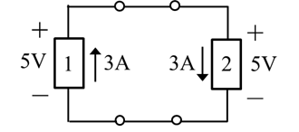
Analogy: Water Flow and Passive Sign Convention
Current through element 1 $→$ uphill (voltage rise)
Like a pump
Current through element 2 $→$ downhill (voltage drop)
Like a watermill
Notes:
Analogy: Water Flow and Passive Sign Convention. We may build on the height analogy for voltage and the water current analogy for electric current to give an analogy for passive sign convention. Consider the two element circuit shown in the slide. The current through element 1 flows “uphill” as it is in the direction of a voltage rise, whereas the current through element 2 flows “downhill” as it is in the direction of a voltage drop. Just as water current requires a pump or other device to supply the power to make the water flow uphill, so does electric current. Thus, element 1 must supply power, which can be calculated via passive sign convention as $\left(5 \text{V}\right)\left(−3 \text{A}\right)= −15 \text{W}$. Similarly, water may deliver power, for example, to a watermill when it flows downhill. In this case, the watermill absorbs power. Element 2 absorbs power, like the watermill, and the absorbed power is $\left(5 \text{V}\right)\left(3 \text{A}\right)= 15 \text{W}$.

Slide 44
Analogy: The Water Cycle and Electric Circuits
Notes:
Analogy: The Water Cycle and Electric Circuits. Consider how evaporation, cloud movement, and precipitation close the loop for the water cycle to enable sustained water current in streams and rivers, just as an emf and wire (or other conducting surface) is needed to close the loop in an electric circuit for sustained electric current. Note how draught conditions can cause streams to dry up (no current).

Slide 45
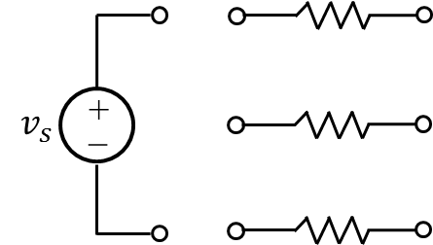
Validation Ex L5-1: Series & Parallel Elements
Series-connected elements may be drawn in parallel and parallel-connected elements may be drawn collinearly.
Draw the wires for the circuit in Fig. L5-1a so that the resistors are connected in series with the voltage source $v_{s}$.
Draw the wires for the circuit in Fig. L5-1b so that the resistors are connected in parallel with the voltage source $v_{s}$.
Notes:
Use this exercise to help avoid the misconception that series-connected resistors must be along a line or that parallel-connected resistors must be geometrically parallel. This is a great pairwise active learning activity to do in class.

Slide 46
Validation Ex L5-1: Series & Parallel Elements
Series-connected elements may be drawn in parallel and parallel-connected elements may be drawn collinearly.
Draw the wires for the circuit in Fig. L5-1a so that the resistors are connected in series with the voltage source $v_{s}$.
Draw the wires for the circuit in Fig. L5-1b so that the resistors are connected in parallel with the voltage source $v_{s}$.
Notes:
Obviously, there is not a unique solution here…mention this.

Slide 47
The equivalent resistance of N series resistors $R_{1},R_{2},…,R_{N}$ is the sum of the resistances
$$R_{\text{series}}=\sum_{i=1}^{N}{R_{i}} (\text{L}4\text{−}3)$$
Analogy: Series resistors play tug of war
Notes:
Analogy: Series resistors play tug of war. Kids on one team in tug of war pull side by side in a line to additively increase their force in pulling the rope with the goal to resist the other team’s force (to resist forward motion of the team). The current-resisting effects of series resistors combine to additively increase the overall resistance.
Be sure to mention the limitation of the analogy that the kids have to be placed along the same line to have the “series” effect work, whereas series-connected resistors do not physically need to be in a line (see previous slides for supportive exercise to avoid transferring this misconception).

Slide 48
Analogy: Voltage division is like tug of war
Each team member supplies a force
resists the other team,
fraction of the total force
Notes:
Analogy: Voltage division is like tug of war. Kids on one team in tug of war pull side by side in a line to additively increase their force in pulling the rope with the goal to resist the other team’s force in order to resist forward motion of the team. The forward motion resisting ability of each member of the team depends directly on the force the team member supplies to the tug of war rope, which is a fraction of the overall force supplied by the team!

Slide 49
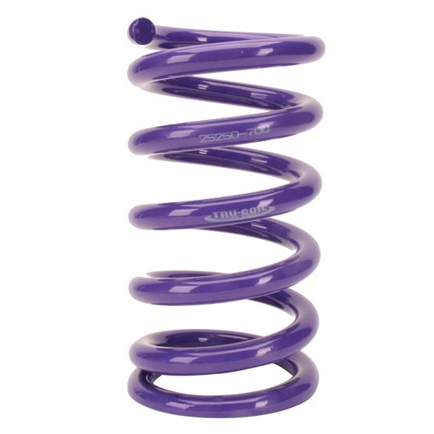
Analogy: Caps are like springs!
$$V_{C}=\left(\frac{1}{C}\right)Q$$
$$F_{spring}=−kx$$
$$W_{cap}=\frac{1}{2}\left(\frac{1}{C}\right)Q^{2}$$
$$W_{spring}=\frac{1}{2}kx^{2}$$
Notes:
Voltage is like force; charge is like displacement; reciprocal of capacitance is like the spring constant. Note that capacitance C is like the reciprocal of the spring constant since a smaller capacitor will provide a larger voltage swing for a small change in charge stored, just as a stronger spring will provide a larger force for a small displacement. Energy storage also follows the analogy. We need to think of the spring being latched in its compressed state to continue the analogy for the case if we disconnect the voltage source.

Slide 50
Inductor Properties
The current through an inductor CANNOT change instantaneously
infinite derivative, requires infinite voltage!
magnetic field continuity
voltage CAN change abruptly.
Notes:
One example of how we build on the previously established analogies that have rich deep structure.

Slide 51
Mnemonic
CIVIL
For a Capacitor, I leads V (current leads voltage by 90$°$);
V leads I for an inductor L (voltage leads current by 90$°$)
Notes:
A great elaboration example that makes it easy for students to remember the leading/lagging relationships for circuit energy storage elements.

