Slide 1
Intro to Arduino
Stephanie Gillespie, Ph.D.

Slide 2
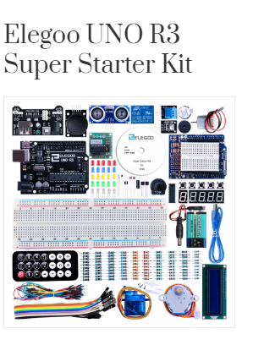
Download software
http://www.elegoo.com/download
Find Arduino IDE for your machine + training code for your kit.
When downloaded, unzip + install on your computer.

Slide 3
What is Arduino?

Slide 4
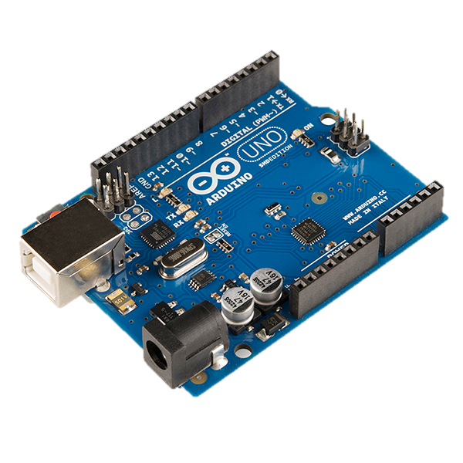
What is Arduino?
An open source, inexpensive embedded development platform.
Belongs to a family of programs meant to make computing accessible:
Wiring (Embedded)
Processing (Graphical, PC)
Fritzing (Circuits, Hardware)

Slide 5
What’s inside?
ATMEL AtMEGA 328
8 bit microcontroller
16 Mhz Operation
6 A/D Channels (10b)
USB for Programming
Up to 19 Digital I/O channels.

Slide 6
Arduino vs Microcontroller
Microcontroller- a compact integrated circuit designed to govern a specific operation in an embedded system. A typical microcontroller includes a processor, memory and input/output (I/O) peripherals on a single chip.
Arduino- open source platform that integrates the microcontroller with electronic components for hobbyists.
Name brand: boards by different manufacturers will vary, software is the same.

Slide 7
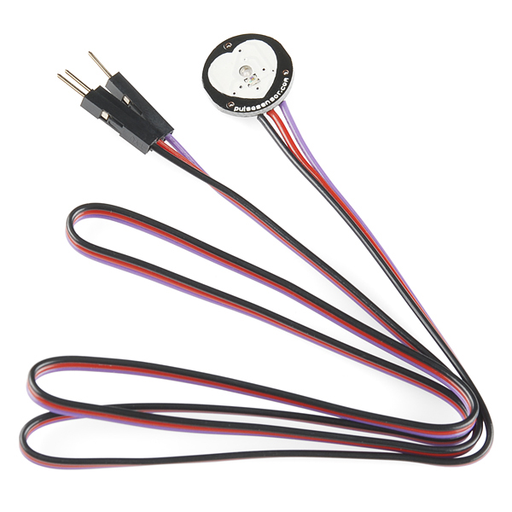
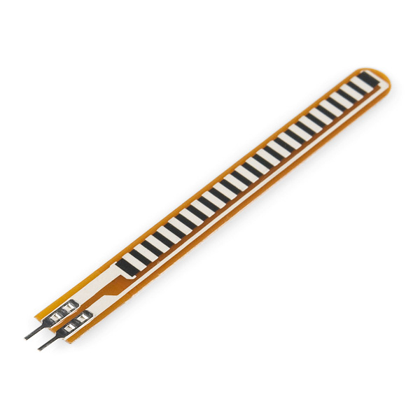
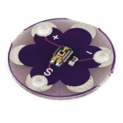
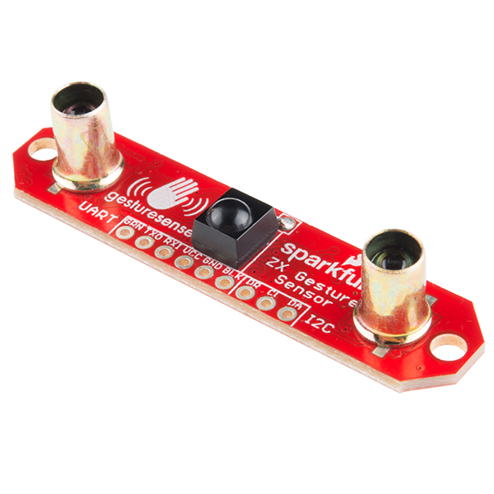
But what can we do with it?
Computer to program sensors, lights, and motors
Pulse sensor
Light sensor
Muscle sensor
Flex sensor
Accelerometer
Distance sensor
Plus MORE!!!

Slide 8
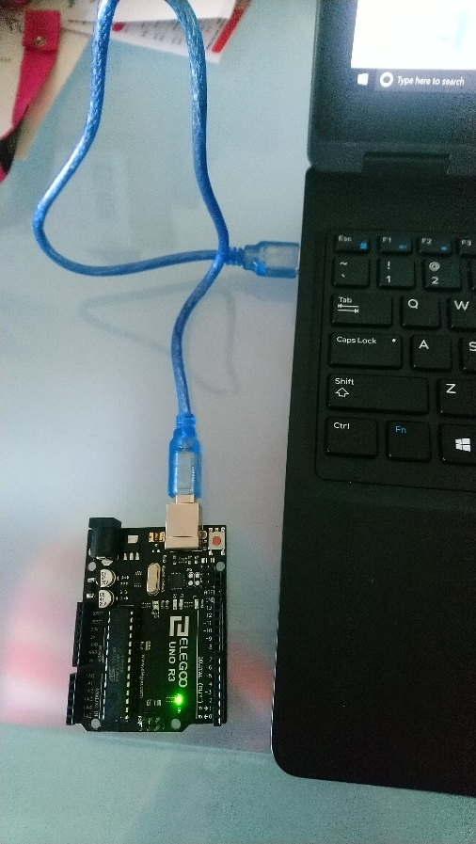
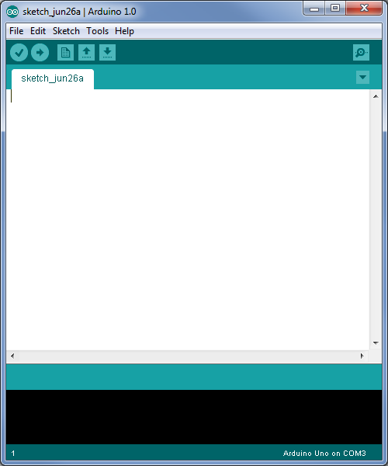
Setup
Connect board to computer via USB cable
Start Arduino.exe
Window Key, type “arduino”, press enter

Slide 9
Setup
Tools->Board->
Arduino Uno

Slide 10
Setup
Tools -> Serial Port -> COM3 or higher

Slide 11
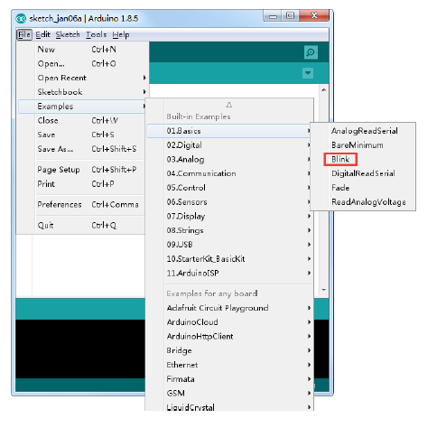
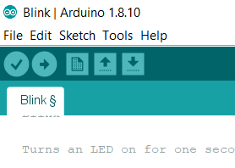
Testing that it works!
Find the example software “blink”
Click the right arrow button to download.
Watch the messages, ensure no errors
Light should blink on/off for 1 second
Go into code, change first ‘1000’ to ‘3000’, re-download, and should see the blinking change

Slide 12
3 Basics of Arduino
Structure
Layout of the code
Functions
How to read and write data to sensors
Variables
Data values
HIGH/LOW, INPUT/OUTPUT, numbers, true/false

Slide 13
Program Structure
Always 2 functions needed to write a program
void setup() {
Where you initialize your inputs and outputs
Start with pinMode( pin #, OUTPUT/INPUT)
void loop() {
Where you write the functionality
digitalRead – use to record the value of a sensor with a true/false option (buttons/switches)
analogRead – use to record sensors with ranges of values
digitalWrite/analogWrite – used to output data

Slide 14
More functions…
To be used inside the loop() function
if ( variable == HIGH) {
contains code for situations with specific circumstances
else {
contains code for situations not covered in the above statement

Slide 15
More functions…
Serial.println(variable)
used to print values of sensors to the computer screen when plugged in
delay( # )
will pause the program for a value in milliseconds

Slide 16
Turn Signal Biker Jacket

Slide 17
Secret Knock Door Lock

Slide 18
Schematic

Slide 19
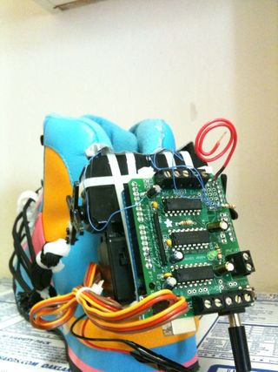
Auto Lacing Tennis Shoes

Slide 20
Lab Procedure
3 tasks as a group:
Must get signoff from Peer Assistant or Faculty on each task
Must rotate programmer on each task and record on signoff sheet.

Slide 21
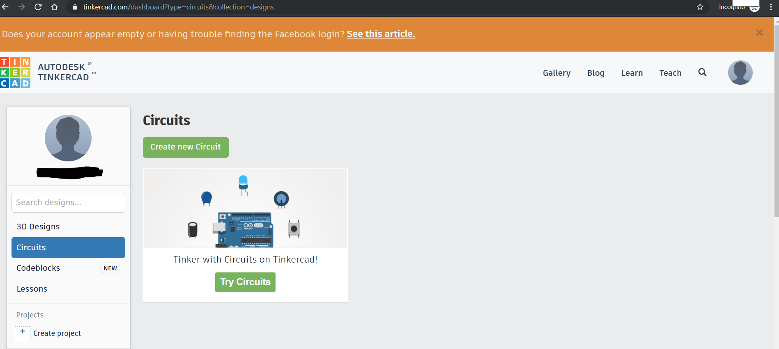
Optional Practice!
Tinkercad.com (will made an account), “circuits” section.
Write a program on the simulator
Connect a green LED to pin 8
Turn on a green LED for 2 seconds
Turn off a green LED for 1 second

Slide 22
Optional Practice
Write a program on the simulator
Connect pin 2 to a green LED
Connect pin 4 to a yellow LED
Connect pin 12 to a red LED
Turn on the green and red LED’s at the same time for 2 seconds
Turn on the yellow LED when the green and red are off for 1 second

Slide 23
Optional Practice
Write a program on the simulator
Connect a push button to pin 7
Connect a red LED to pin 12
Turn on the LED when the button is pressed
Turn off the LED when the button in de-pressed

