Slide 1
Customer Discovery
Lecture Activity

Slide 2
What is value?
What makes a project or product valuable to someone?

Slide 3
Finding Value
What does it do?
What problem does it solve?
Why do people buy it?
What is a different solution?

Slide 4
Finding Value
What does it do?
What problem does it solve?
Why do people buy it?
What is a different solution?

Slide 5
Finding Value
What does it do?
What problem does it solve?
Why do people buy it?
What is a different solution?

Slide 6
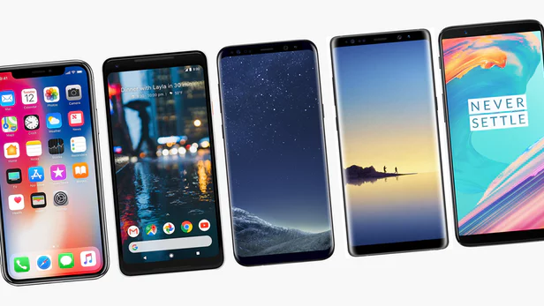
Finding Value
What does it do?
What problem does it solve?
Why do people buy it?
What is a different solution?

Slide 7
Project: Foreign Language Learning
This project involves the development of educational software for an Android device. The software's primary aim is to improve the instruction of pronunciation in a foreign language using a Natural Language Processing module. The software will have three users to consider.
1) Language learners (5-16 years old) who will train and improve English pronunciation, vocabulary, and grammar using voice recognition in an amusing game environment.
2) Non-native speaking instructors of the target language (initially English) who will create drill sets and media based on local curricula.
3) Native speaking researchers who will analyze user progress and provide feedback to instructors in addition to studying effectiveness of software.

Slide 8
Project: Foreign Language Learning
What is the purpose of the project?
Who are the customers?
What is the value of the project to the customers?
What are the questions you would have?
Notes:
Class Discussion

Slide 9
Your Project: Questions
Give a brief overview of your project, as you understand it.
What is the value of this project to your sponsor?
Present the questions you'd like to ask the sponsor.
Class suggestions?
Notes:
Each project team presents, shares, discusses.

Slide 10
Create Extraordinary Value.
Notes:
Value is human-focused. It is not what the project does, but how does it impact the lives of the people that interact with it?

